Slide 1
Prioritizing Cycle Infrastructure Based on Potential Demand

Slide 2
Current mode Share Plots…

Slide 3
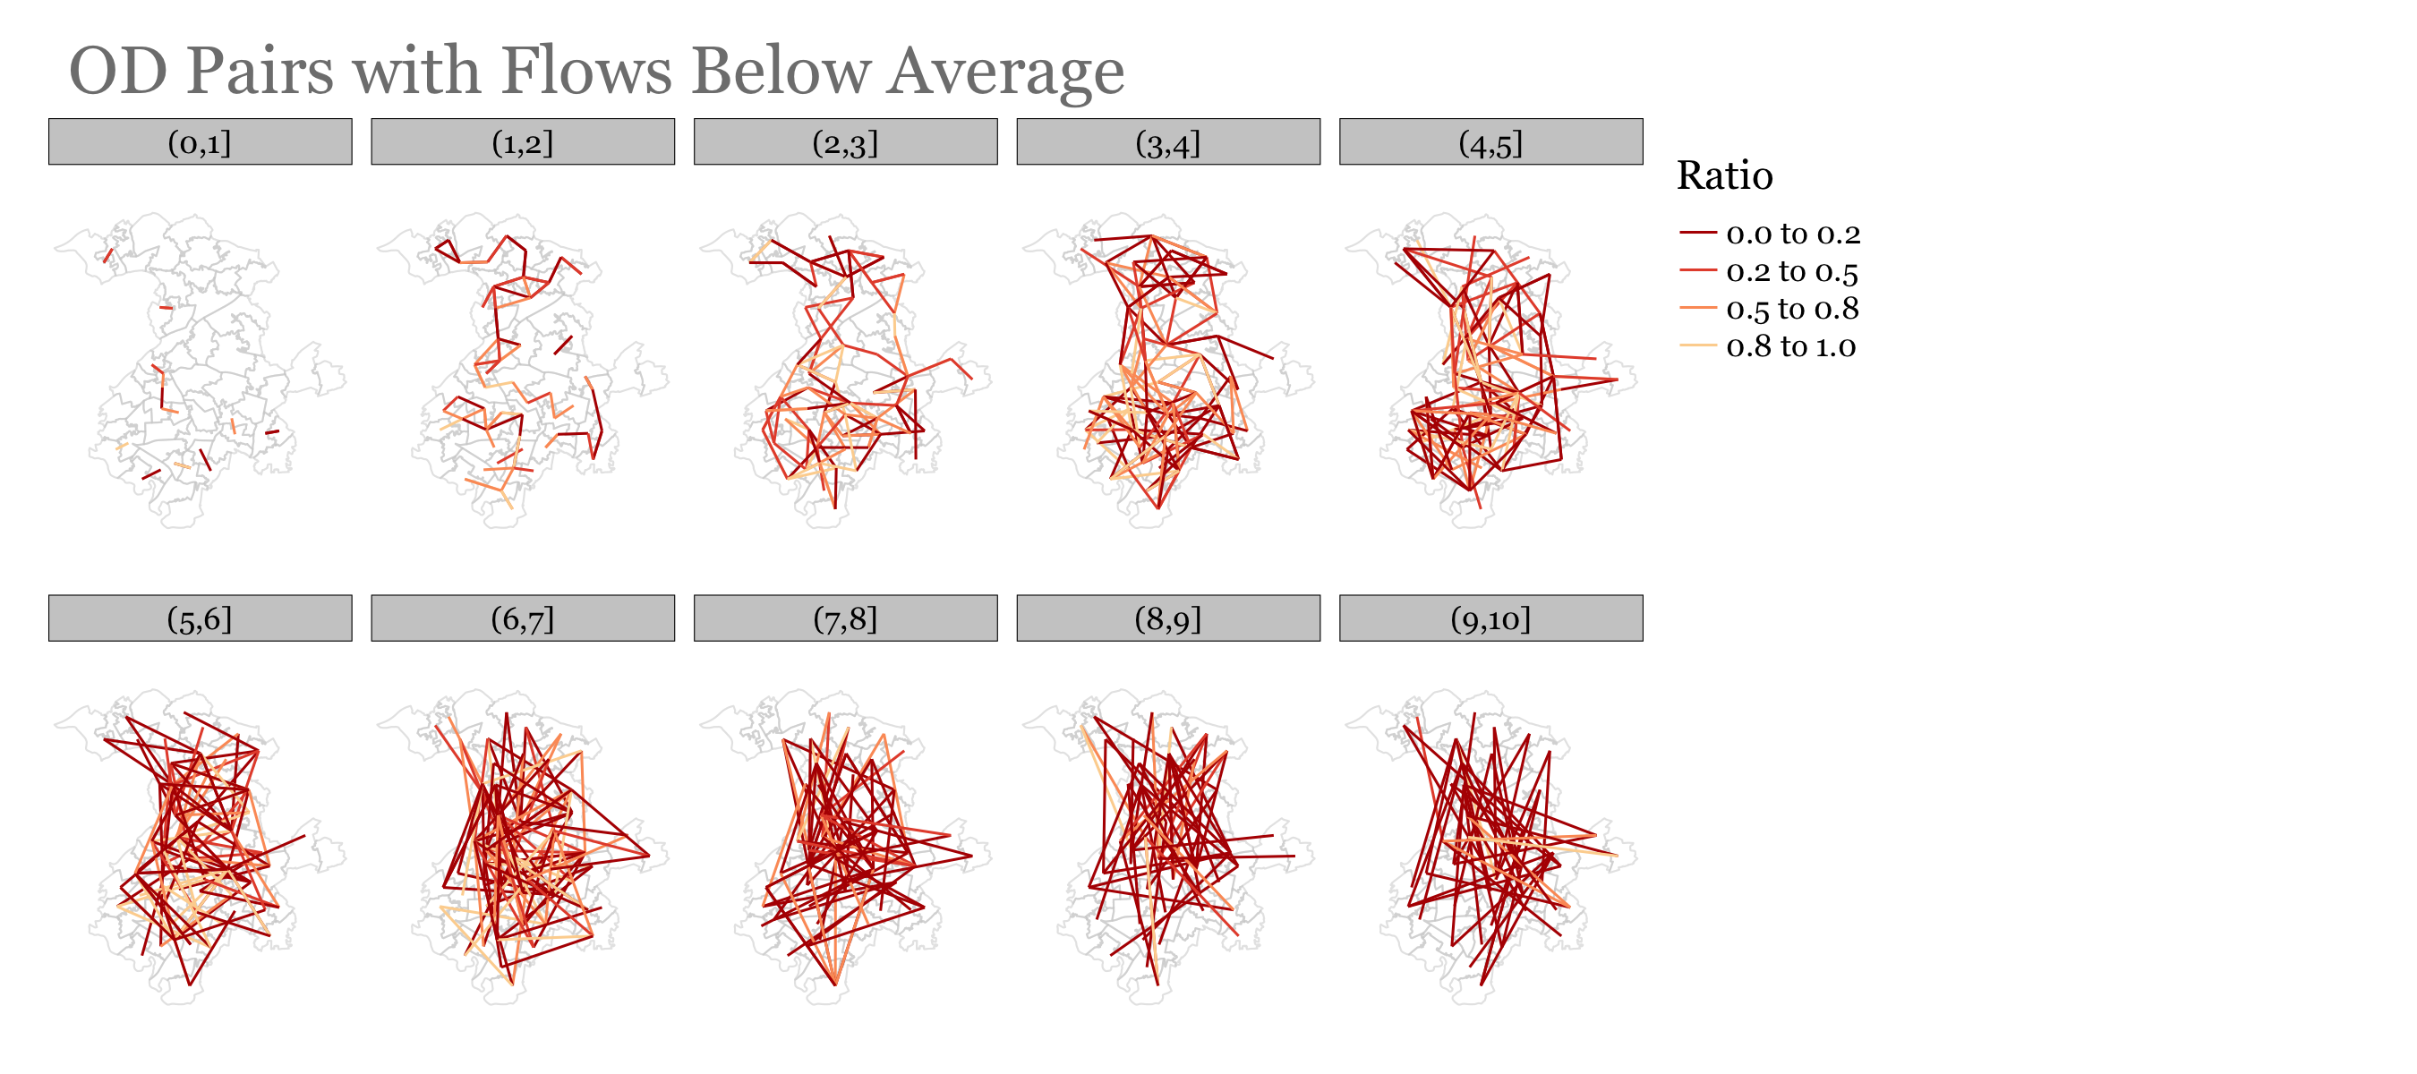

Slide 4
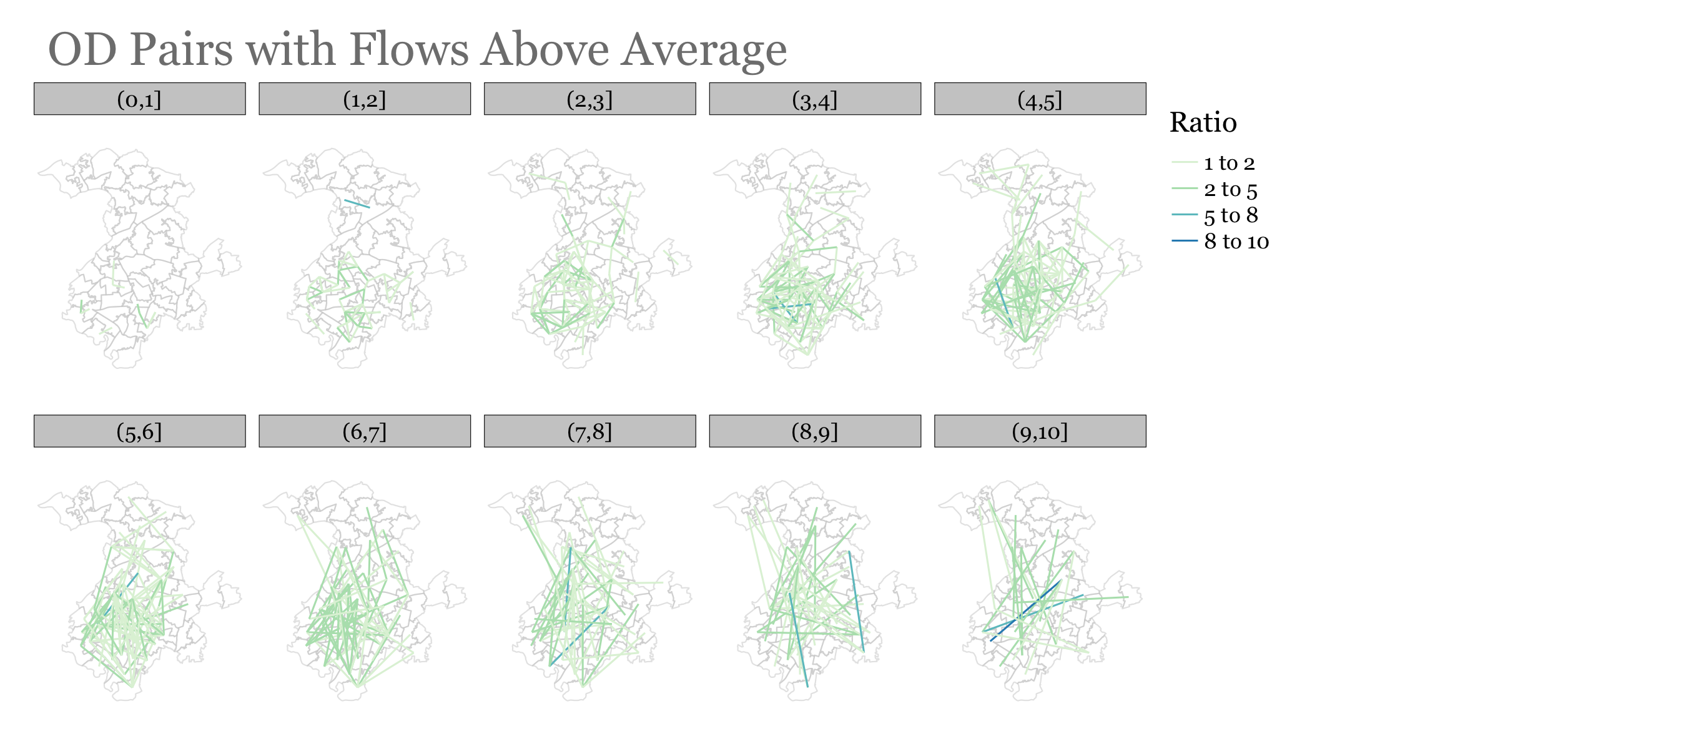

Slide 5
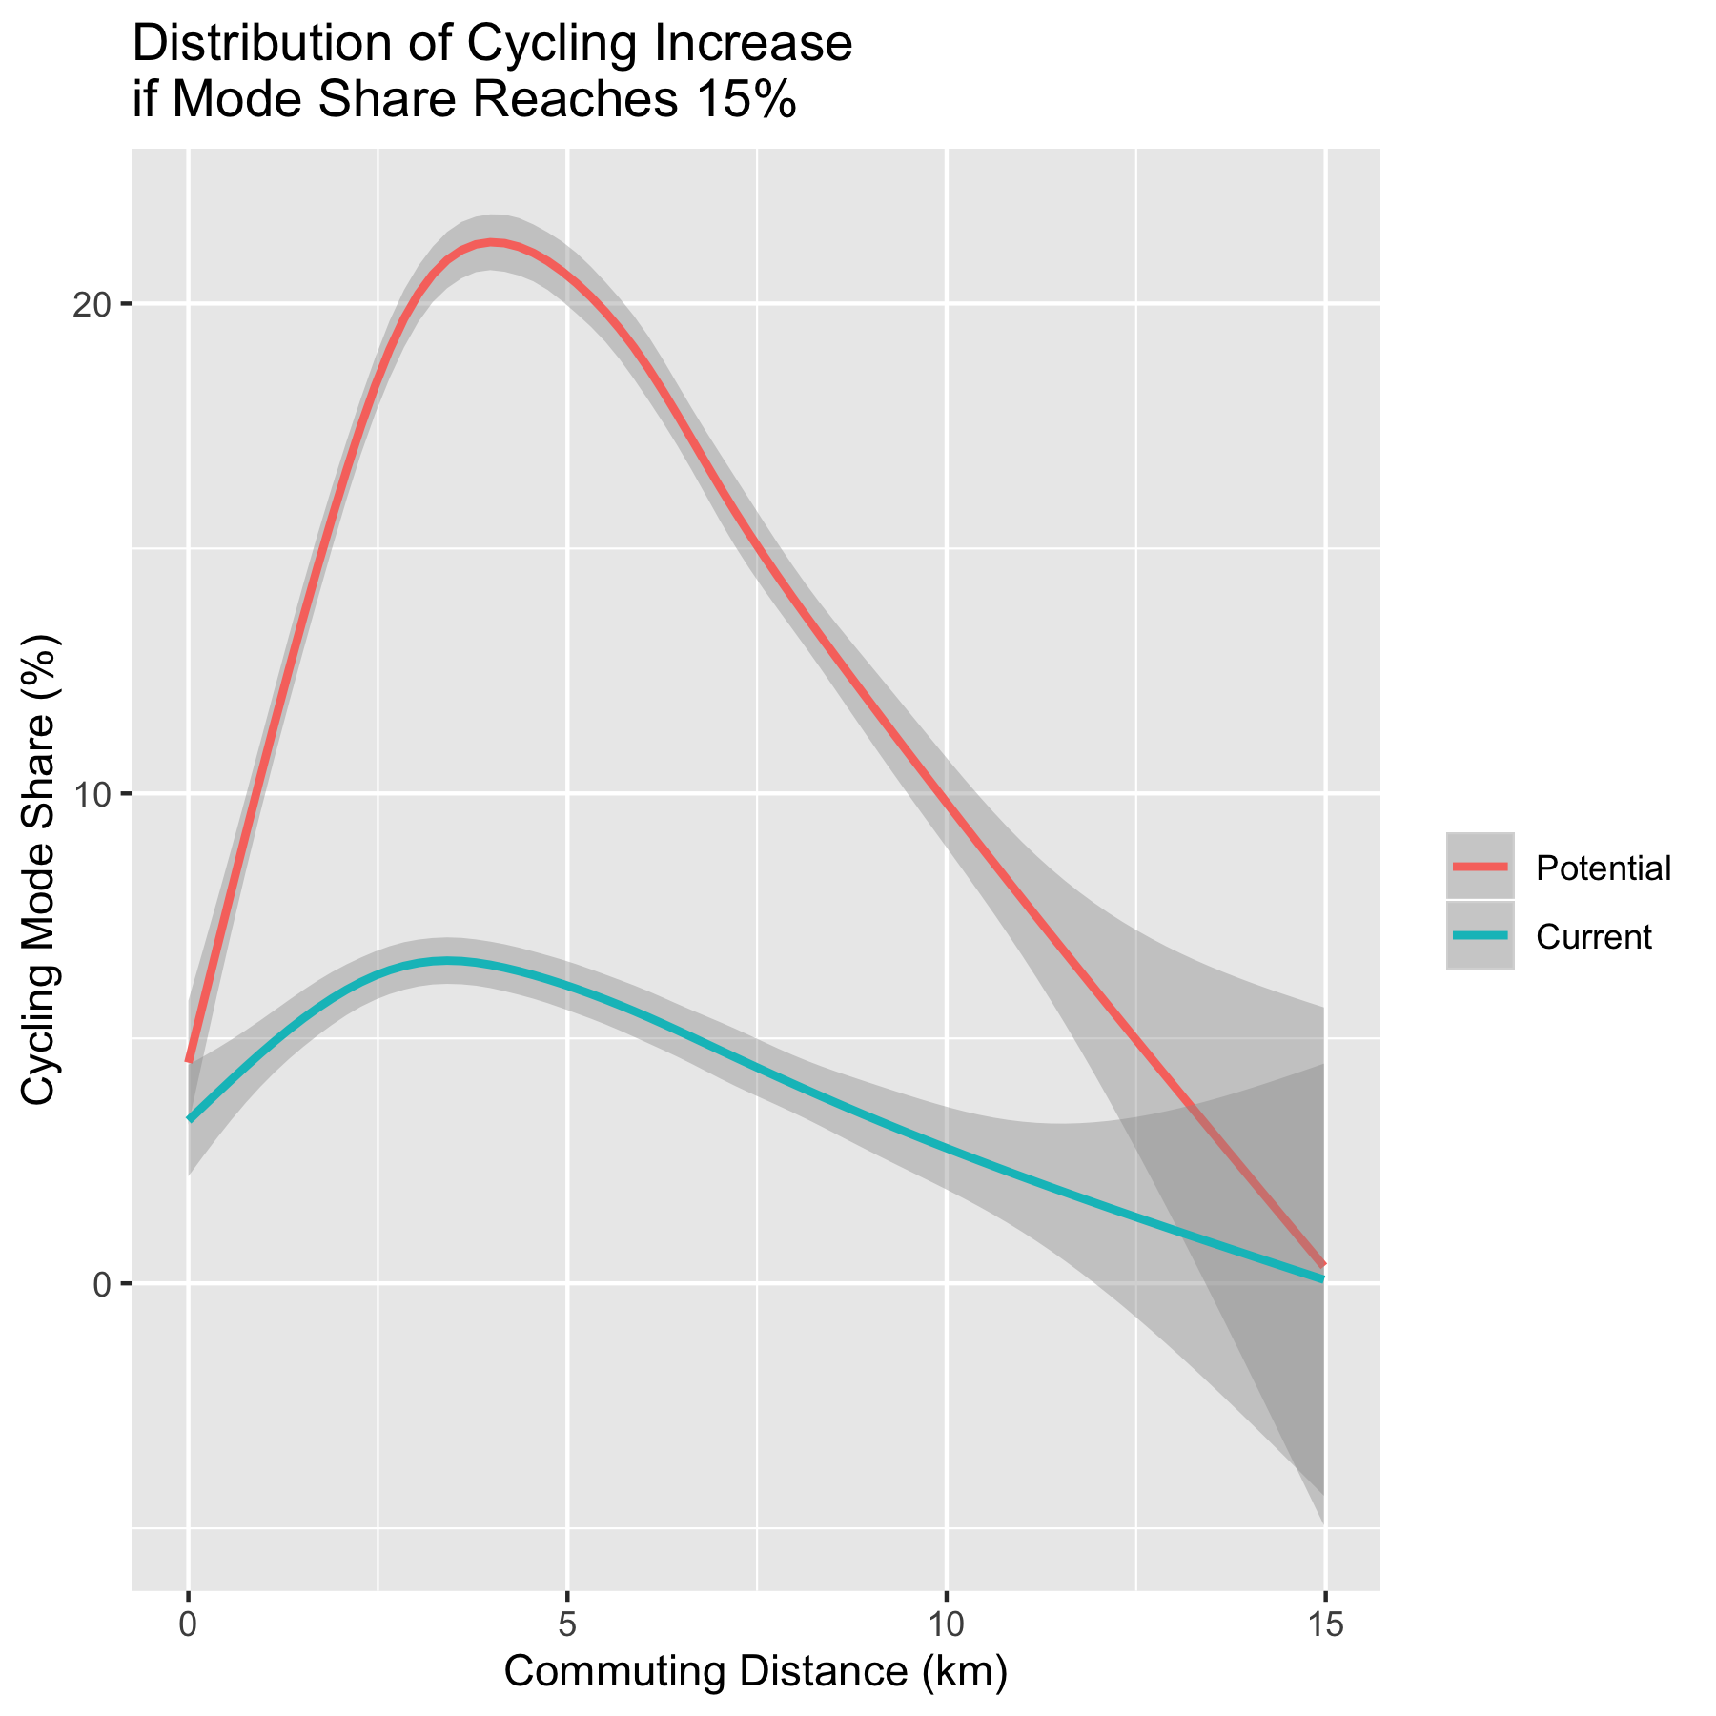

Slide 6
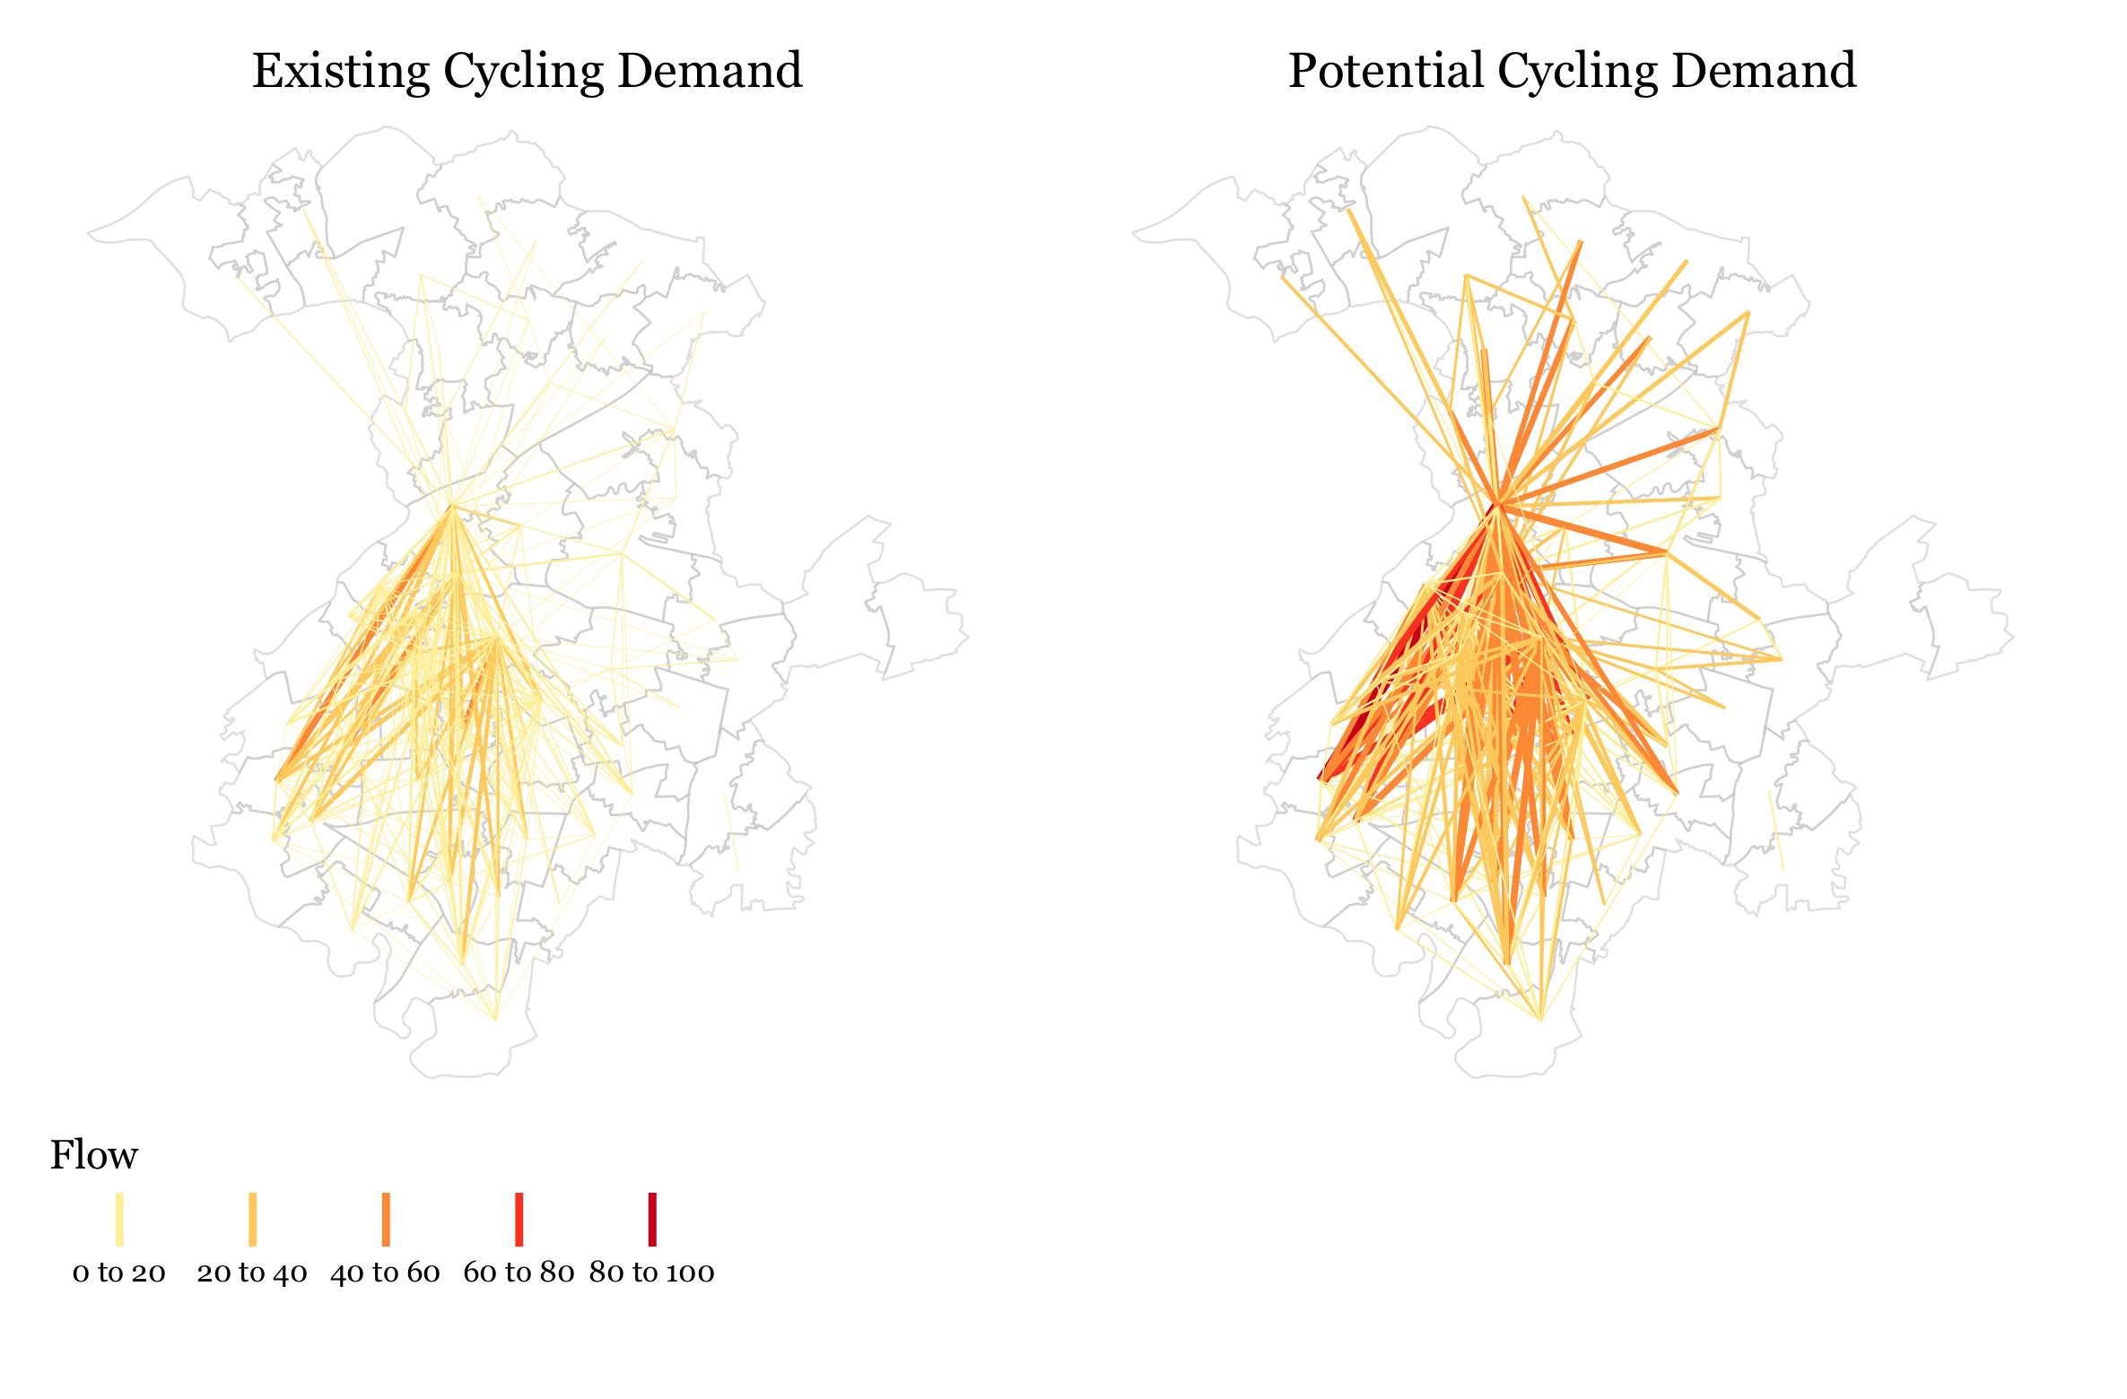

Slide 7
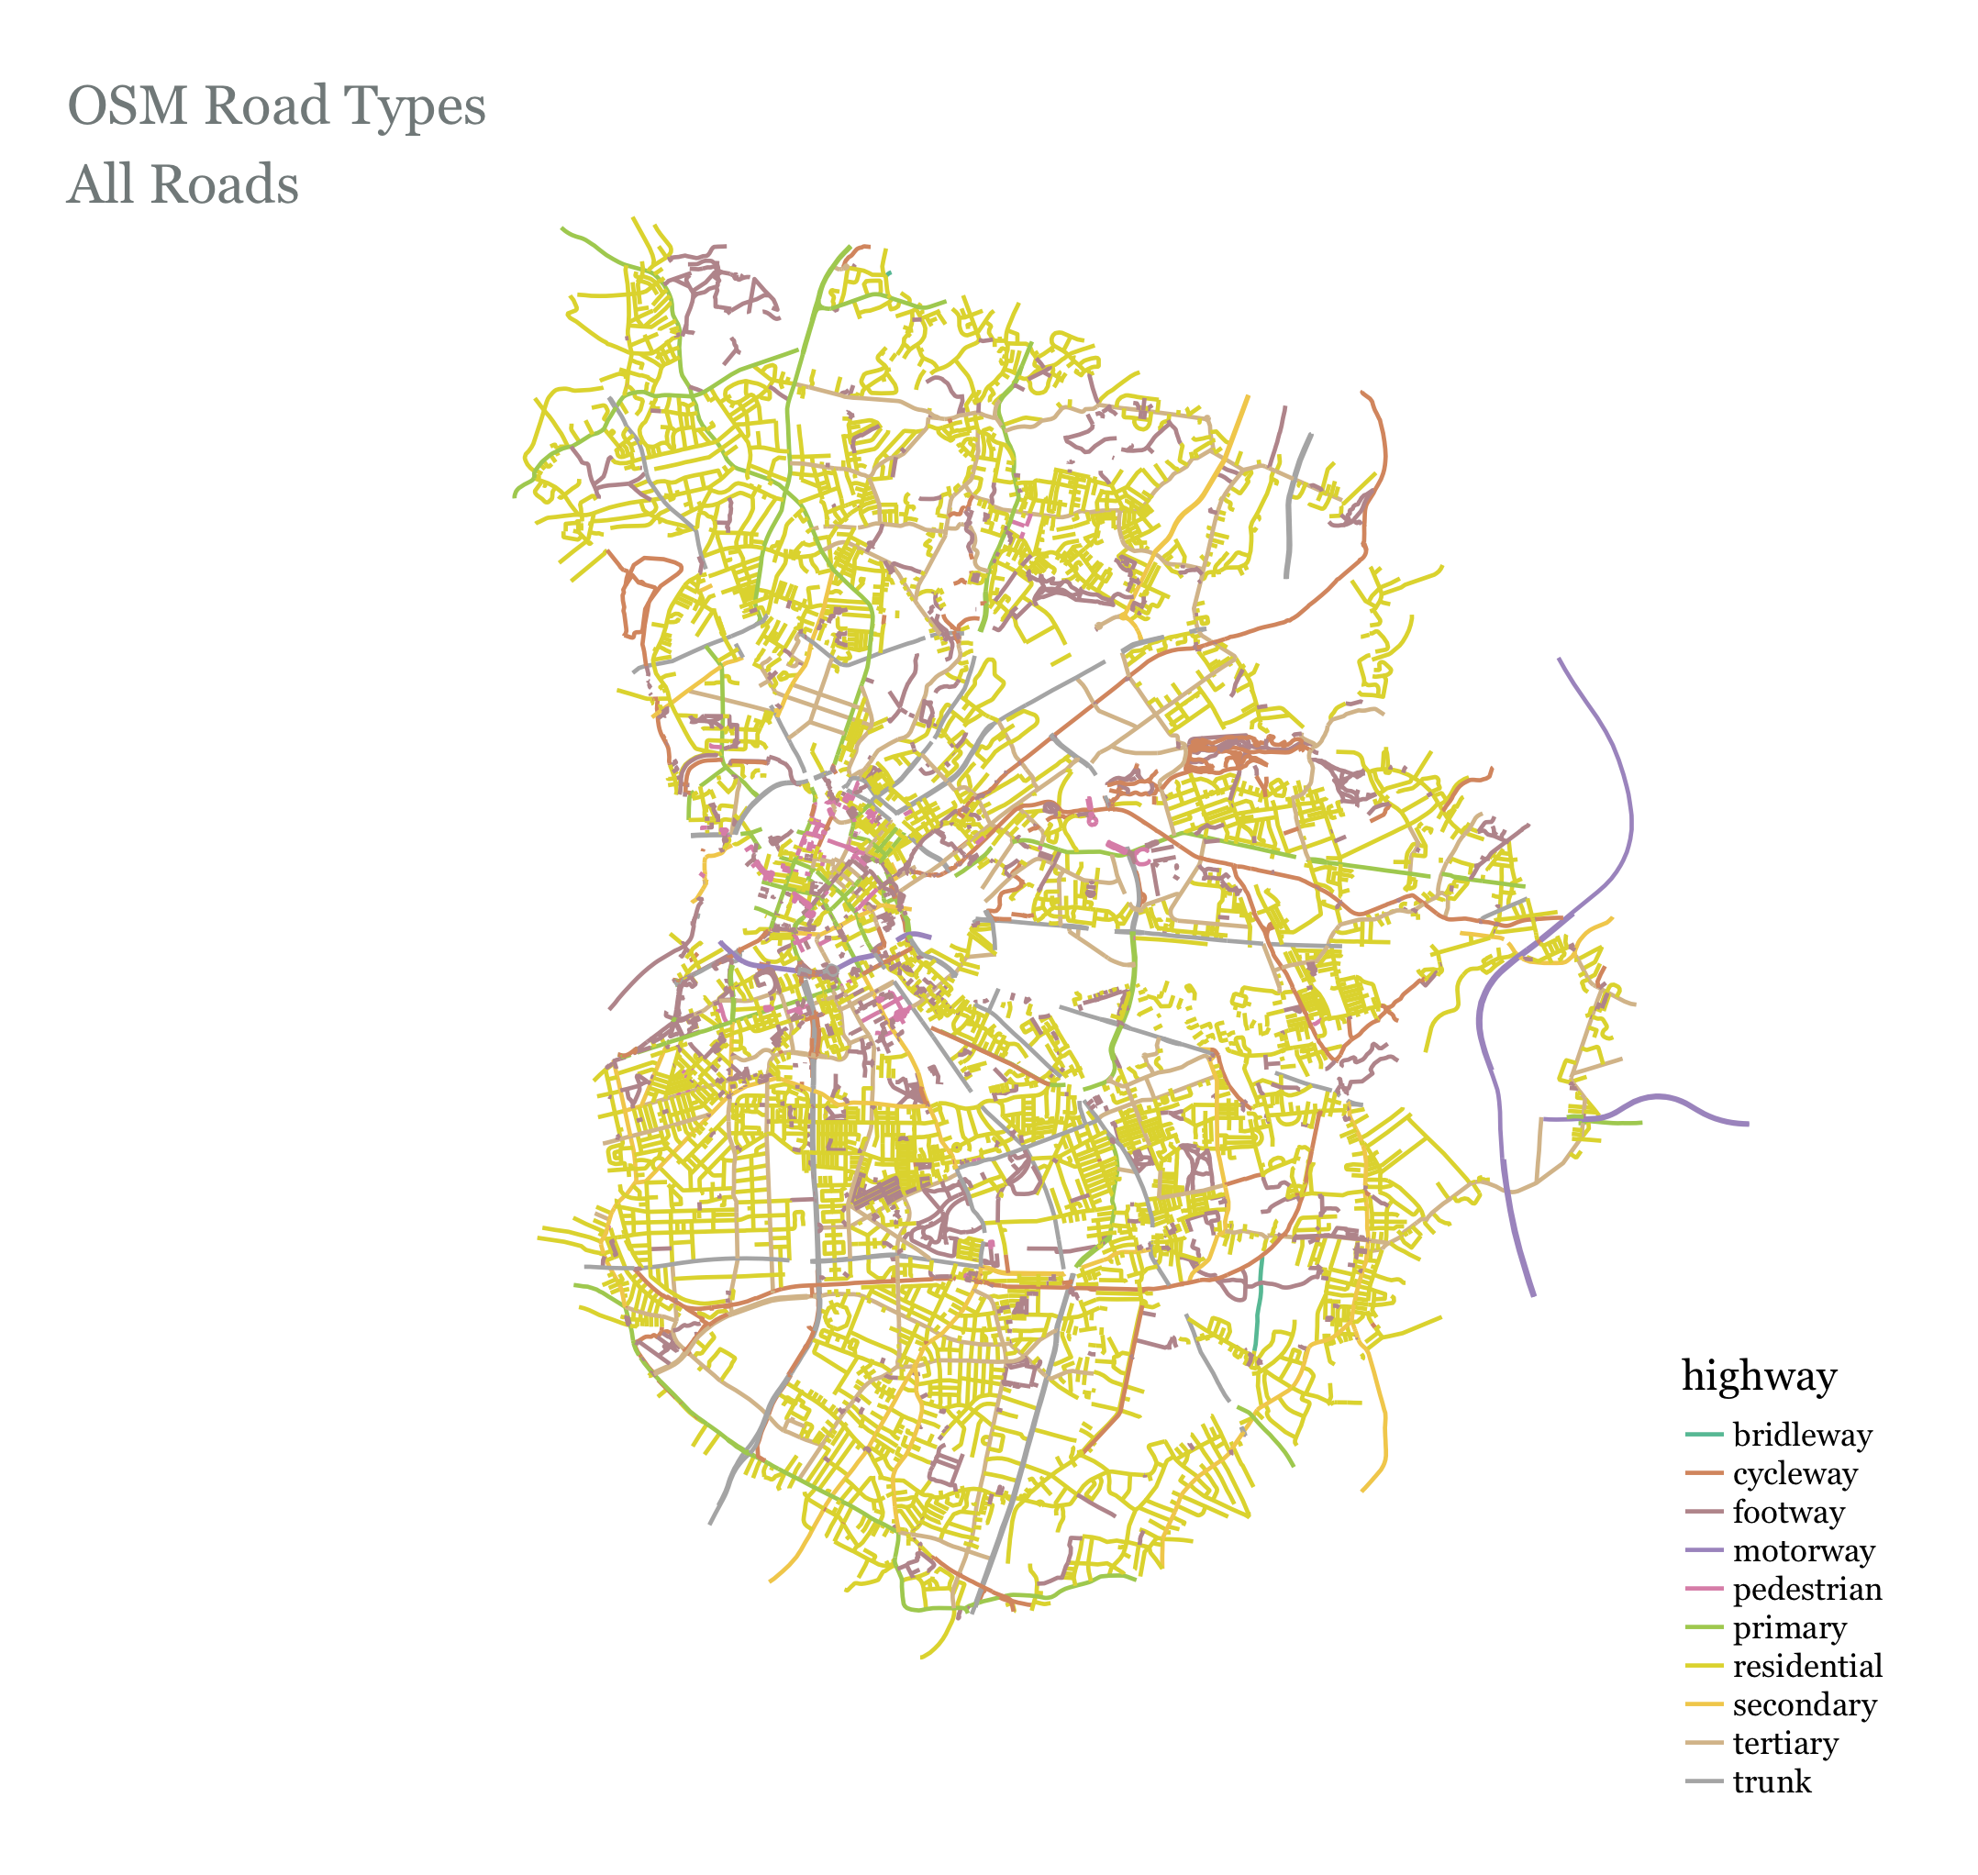

Slide 8
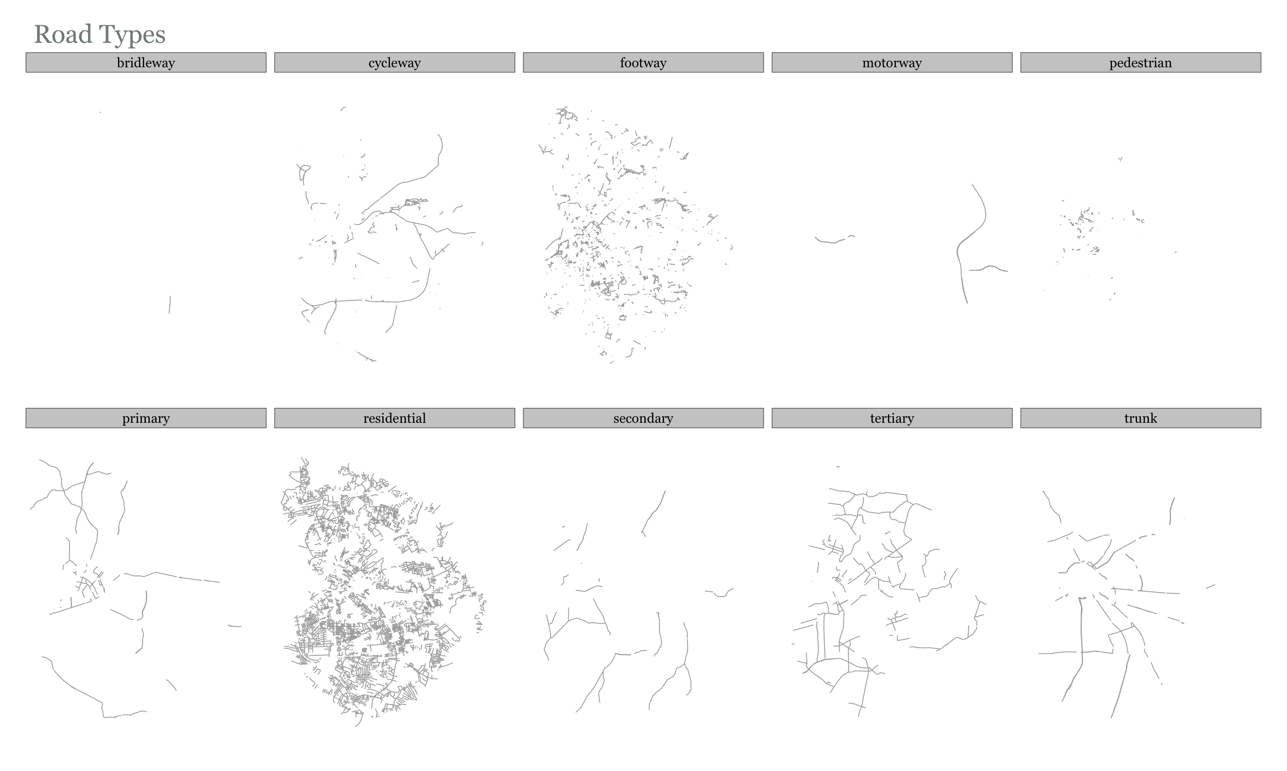

Slide 9
How Do We Route The Flows – Weighting Profiles
Highway Type | 1. Default (from routino) | 2. Reduced Impedence on Trunk Roads | 3. Unweighted Shortest Paths (All roads equal)
motorway | 0 | ‘’ ‘’ ‘’ | 1
trunk | 0.3 | 0.7 | 1
primary | 0.7 | ‘’ ‘’ ‘’ | 1
secondary | 0.8 | ‘’ ‘’ ‘’ | 1
tertiary | 0.9 | ‘’ ‘’ ‘’ | 1
unclassified | 0.9 | ‘’ ‘’ ‘’ | 1
residential | 0.9 | ‘’ ‘’ ‘’ | 1
service | 0.9 | ‘’ ‘’ ‘’ | 1
track | 0.9 | ‘’ ‘’ ‘’ | 1
cycleway | 1 | ‘’ ‘’ ‘’ | 1
path | 0.9 | ‘’ ‘’ ‘’ | 1
steps | 0 | ‘’ ‘’ ‘’ | 1
ferry | 0.2 | ‘’ ‘’ ‘’ | 1
Notes:
the value is the % of commuters/flow that will choose that road type

Slide 10
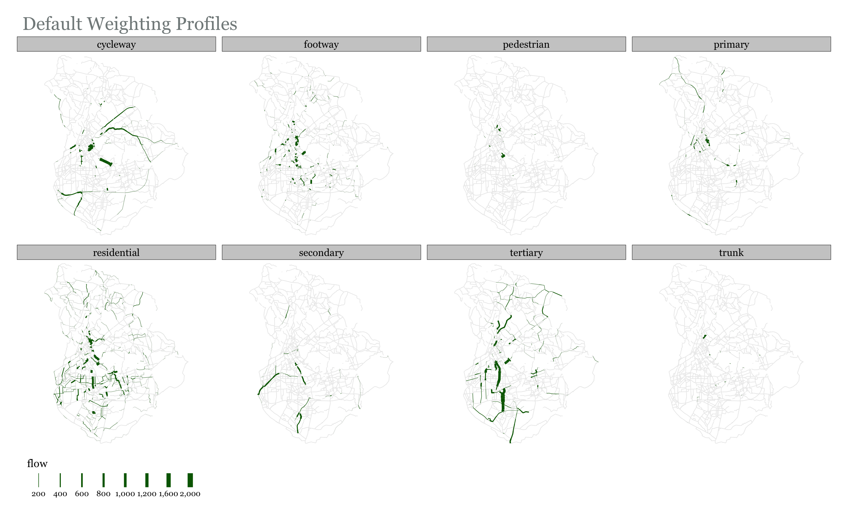

Slide 11
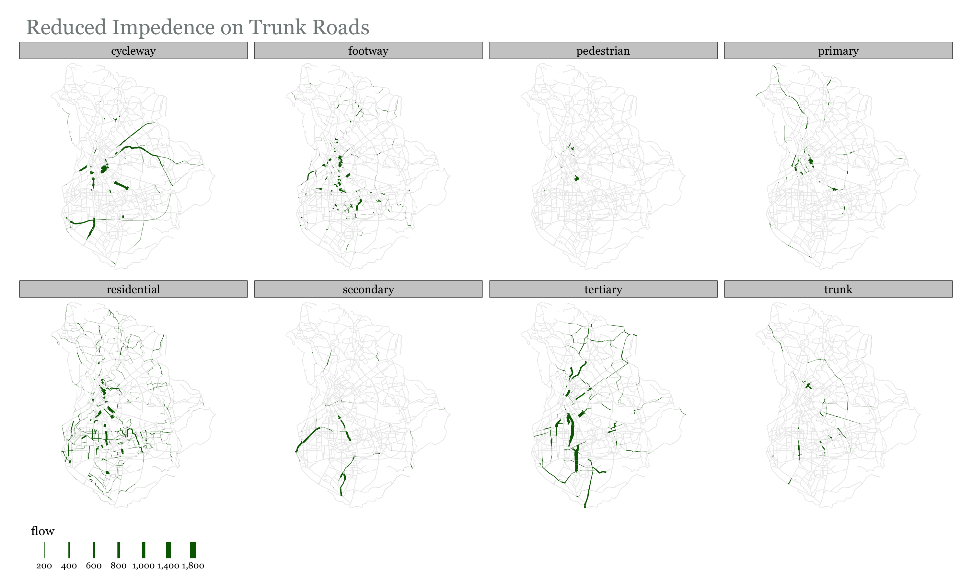

Slide 12
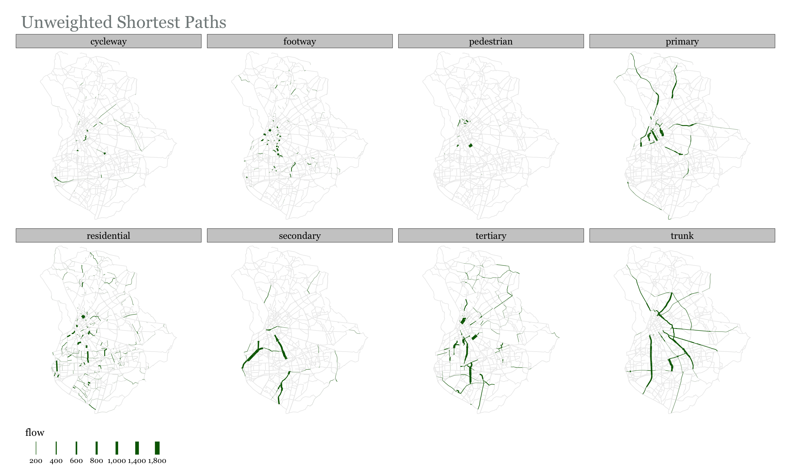

Slide 13
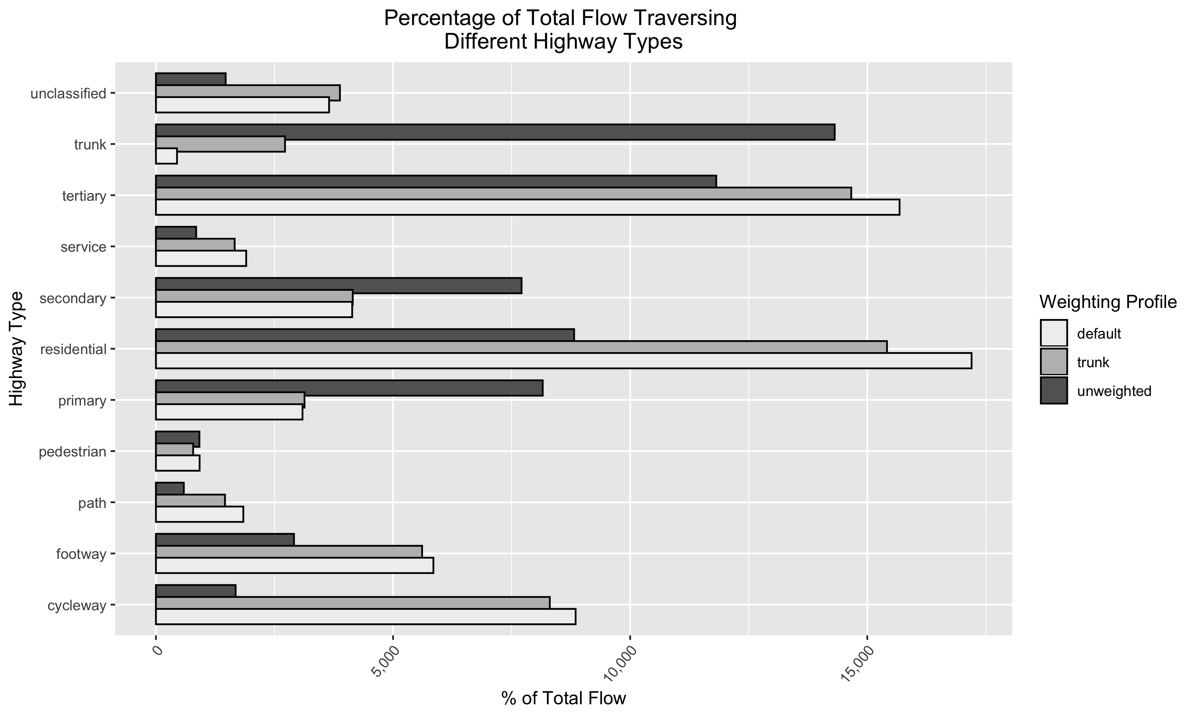

Slide 14
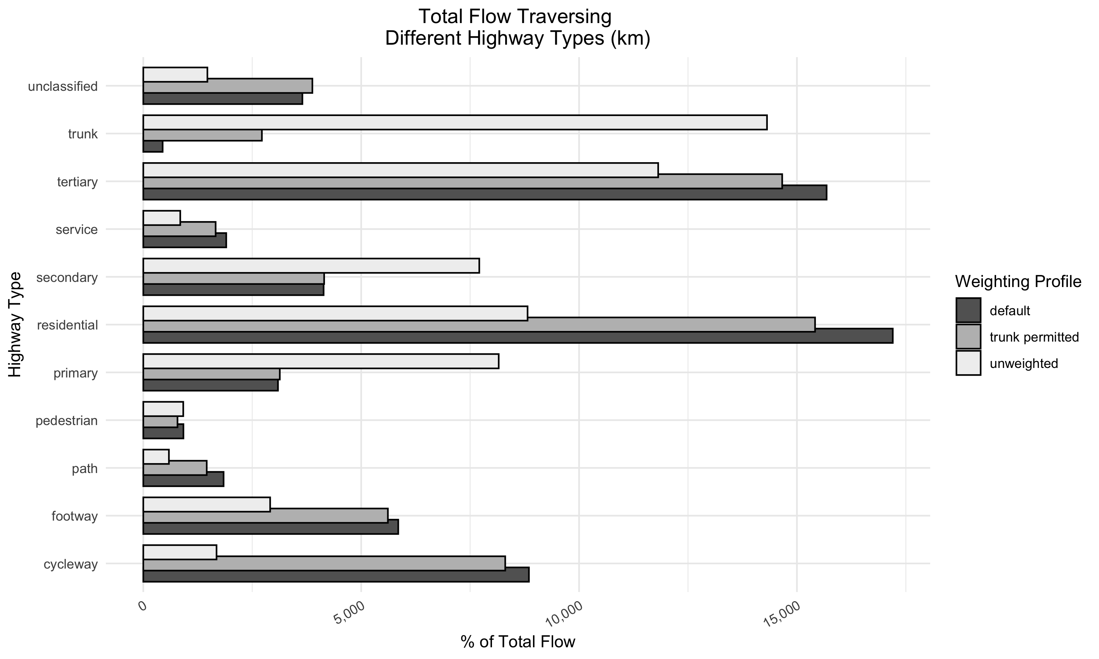

Slide 15
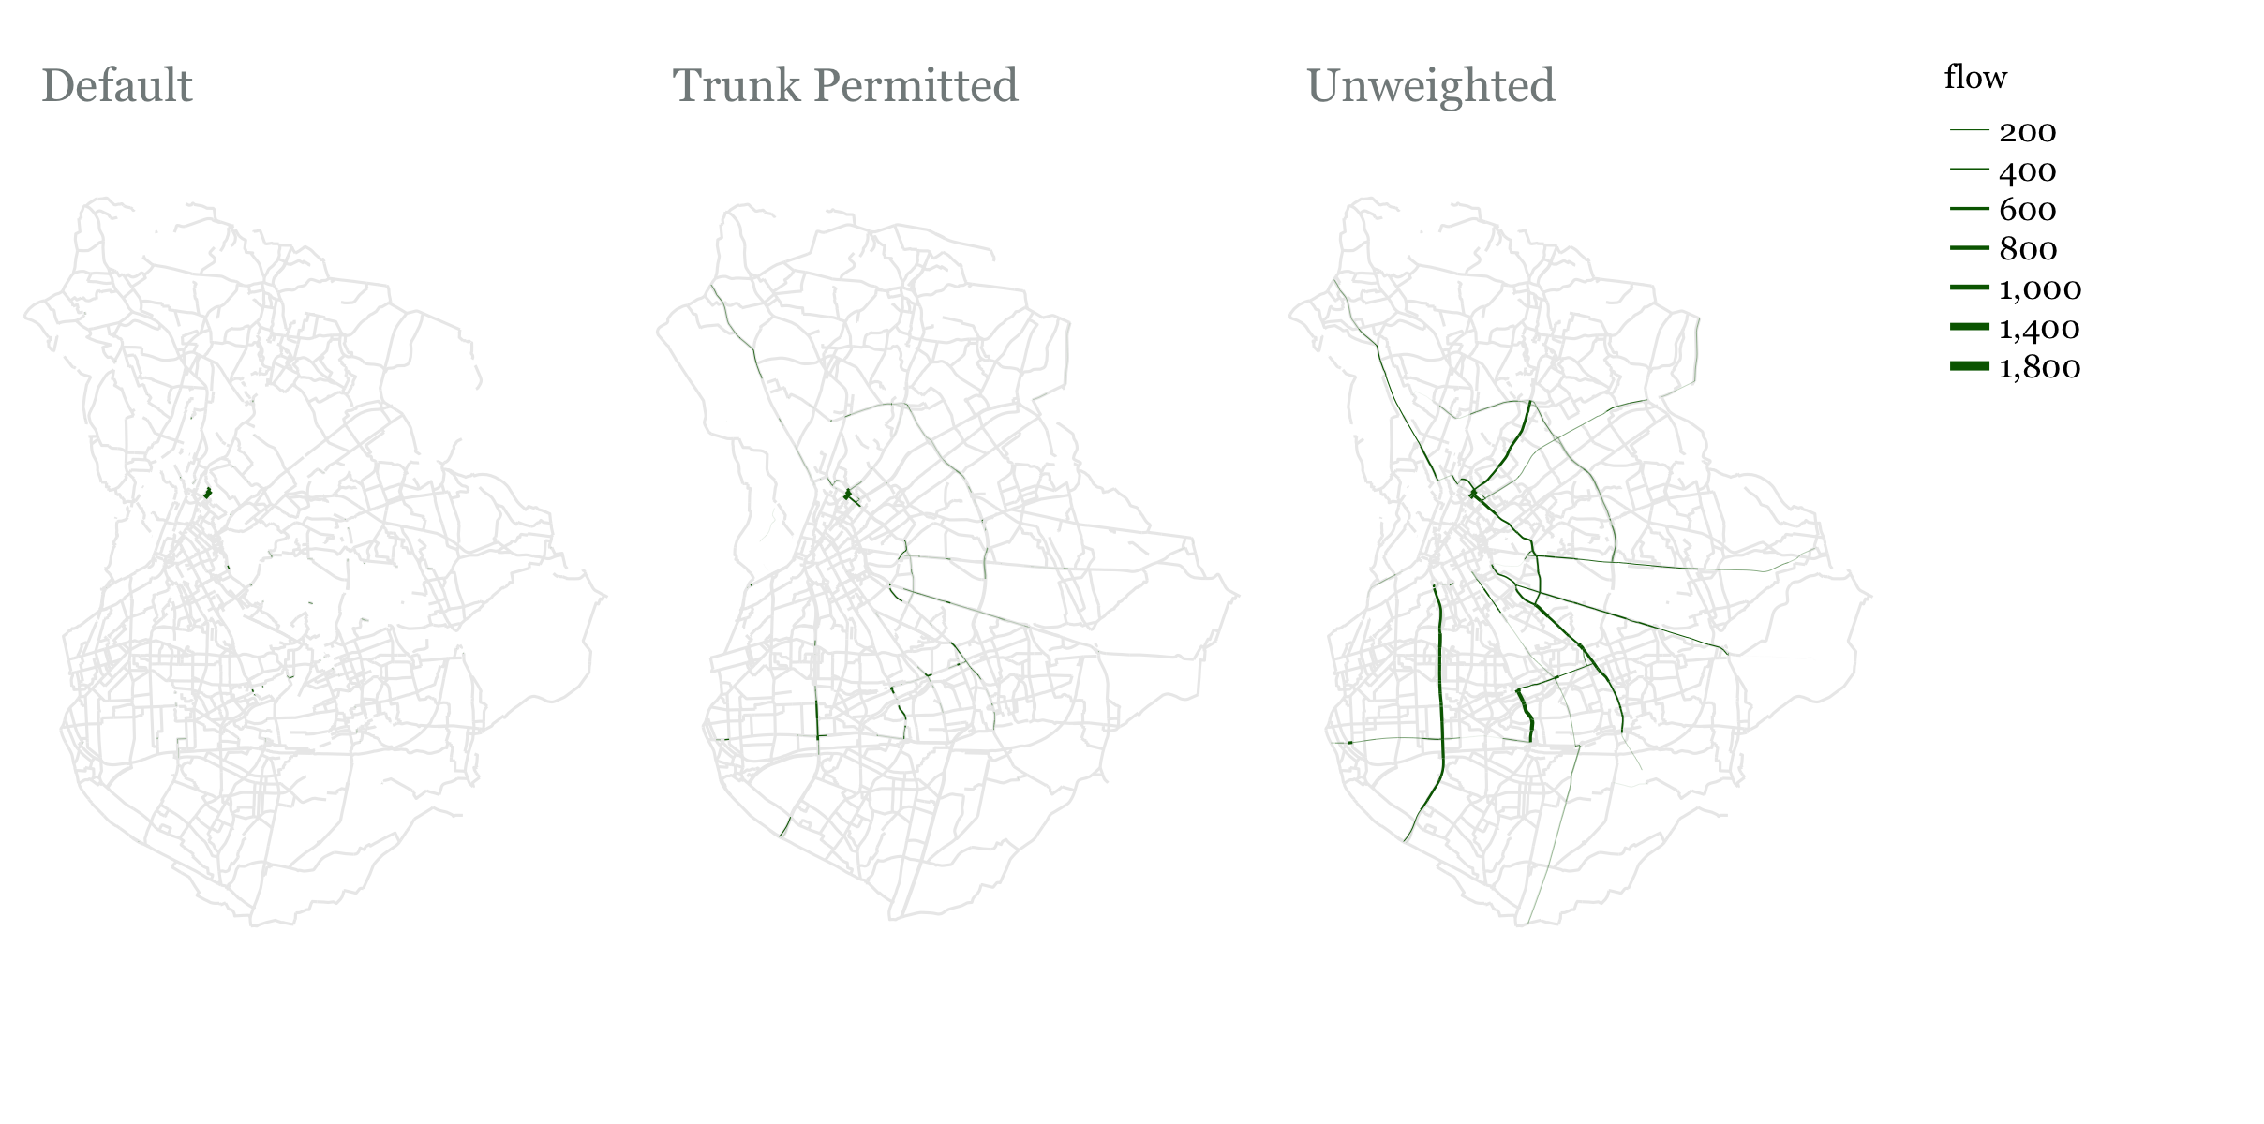
Flow on Trunk Roads

Slide 16
Growing A Network – One Seed
We aim for a connected network. We grow the network incrementally by selecting neighboring edges.
How to prioritize edges?
Flow passing through them: Higher is better
Person_km Satisfied: Edges have different lengths. Person_km satisfied accounts for that. It is equal to: Flow on edge * length of edge

Slide 17
Run the algorithm/s and add plots here

Slide 18
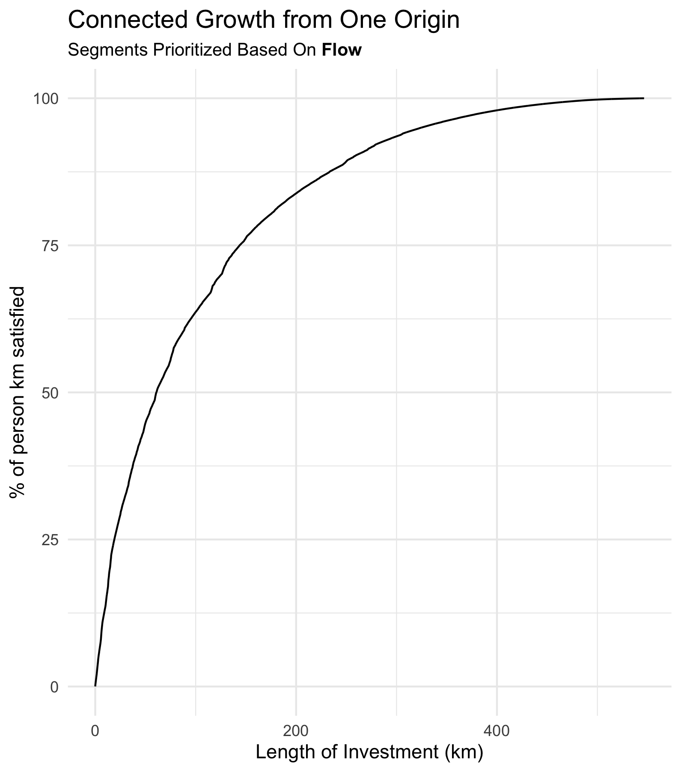
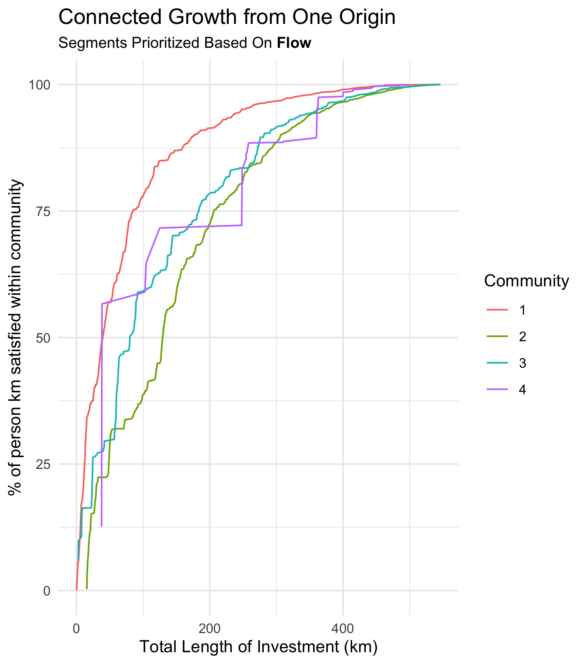

Slide 19
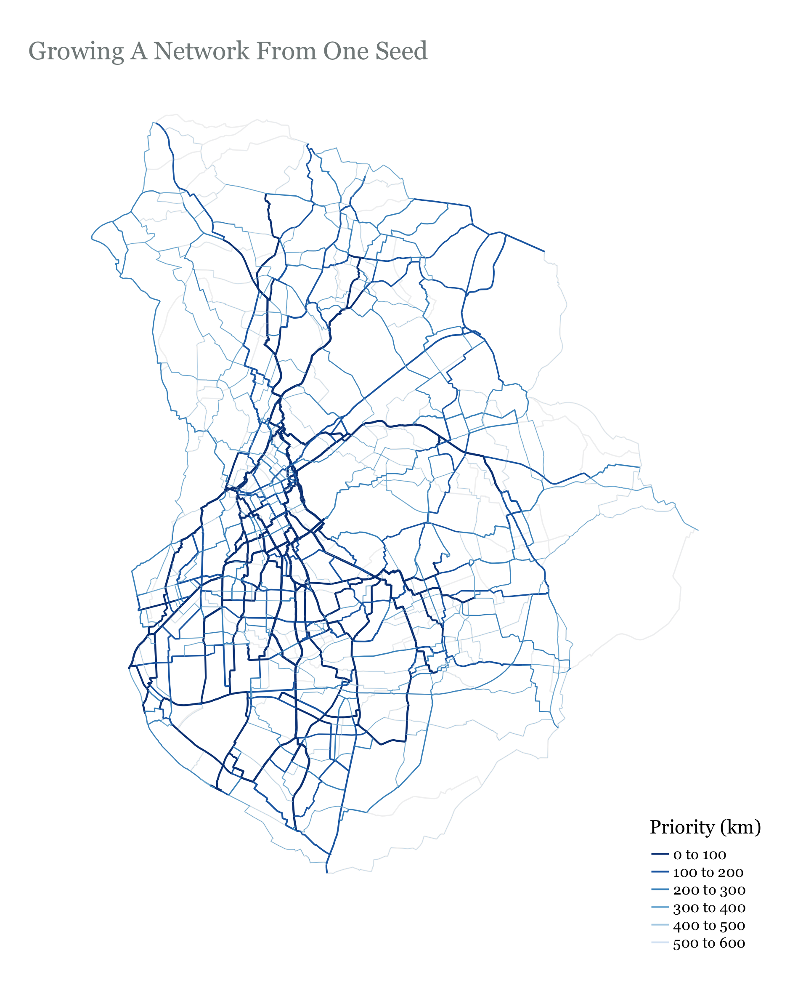

Slide 20
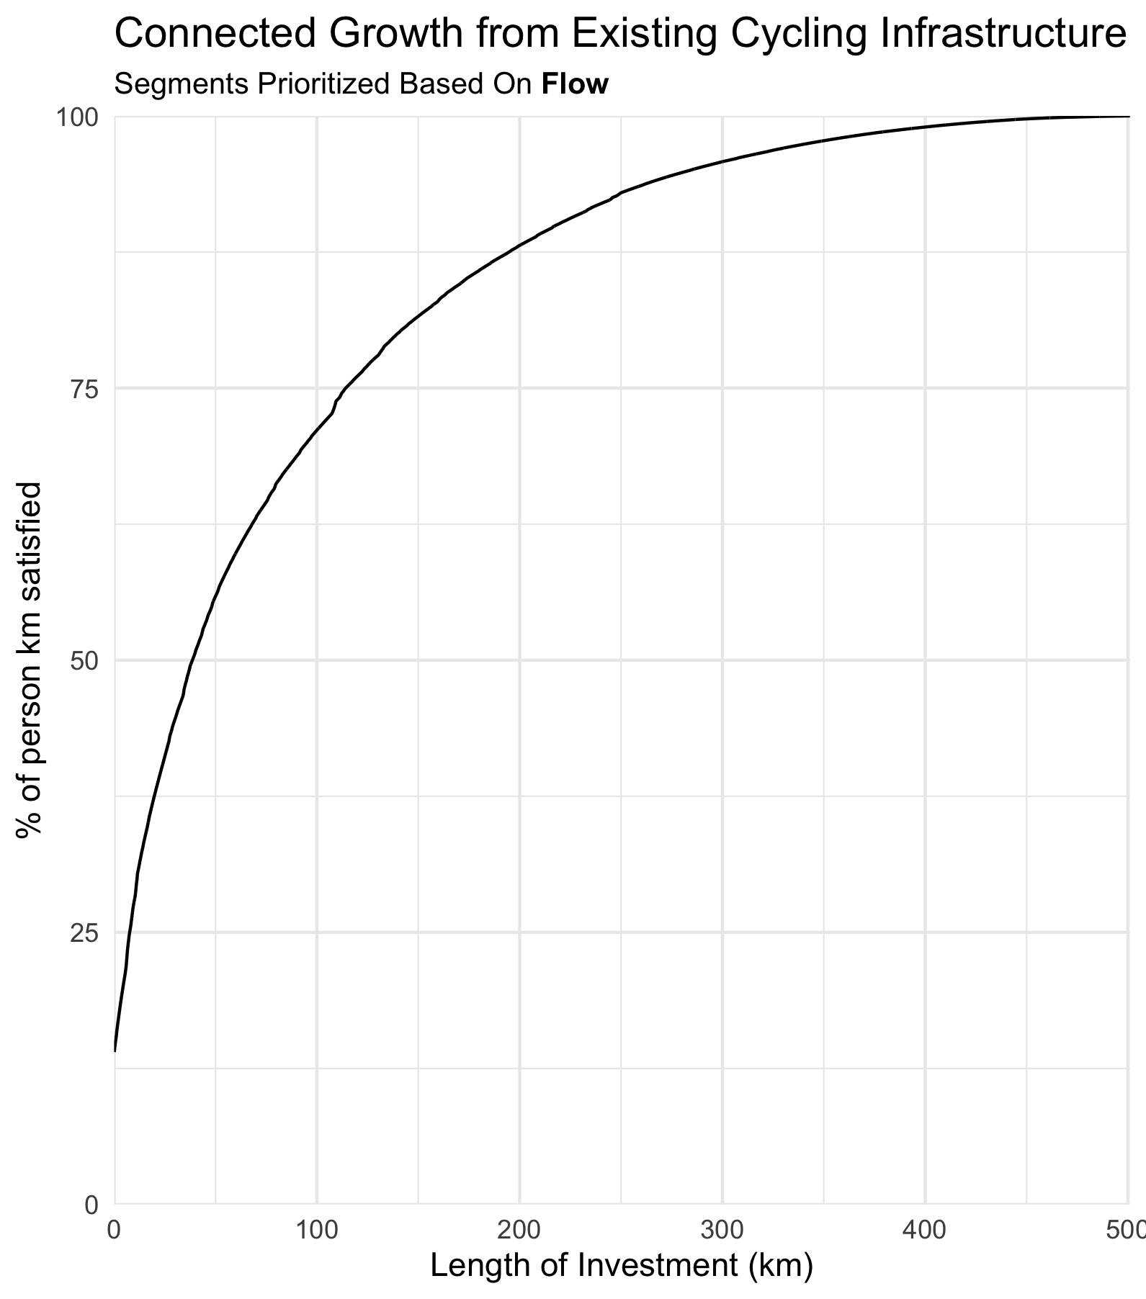
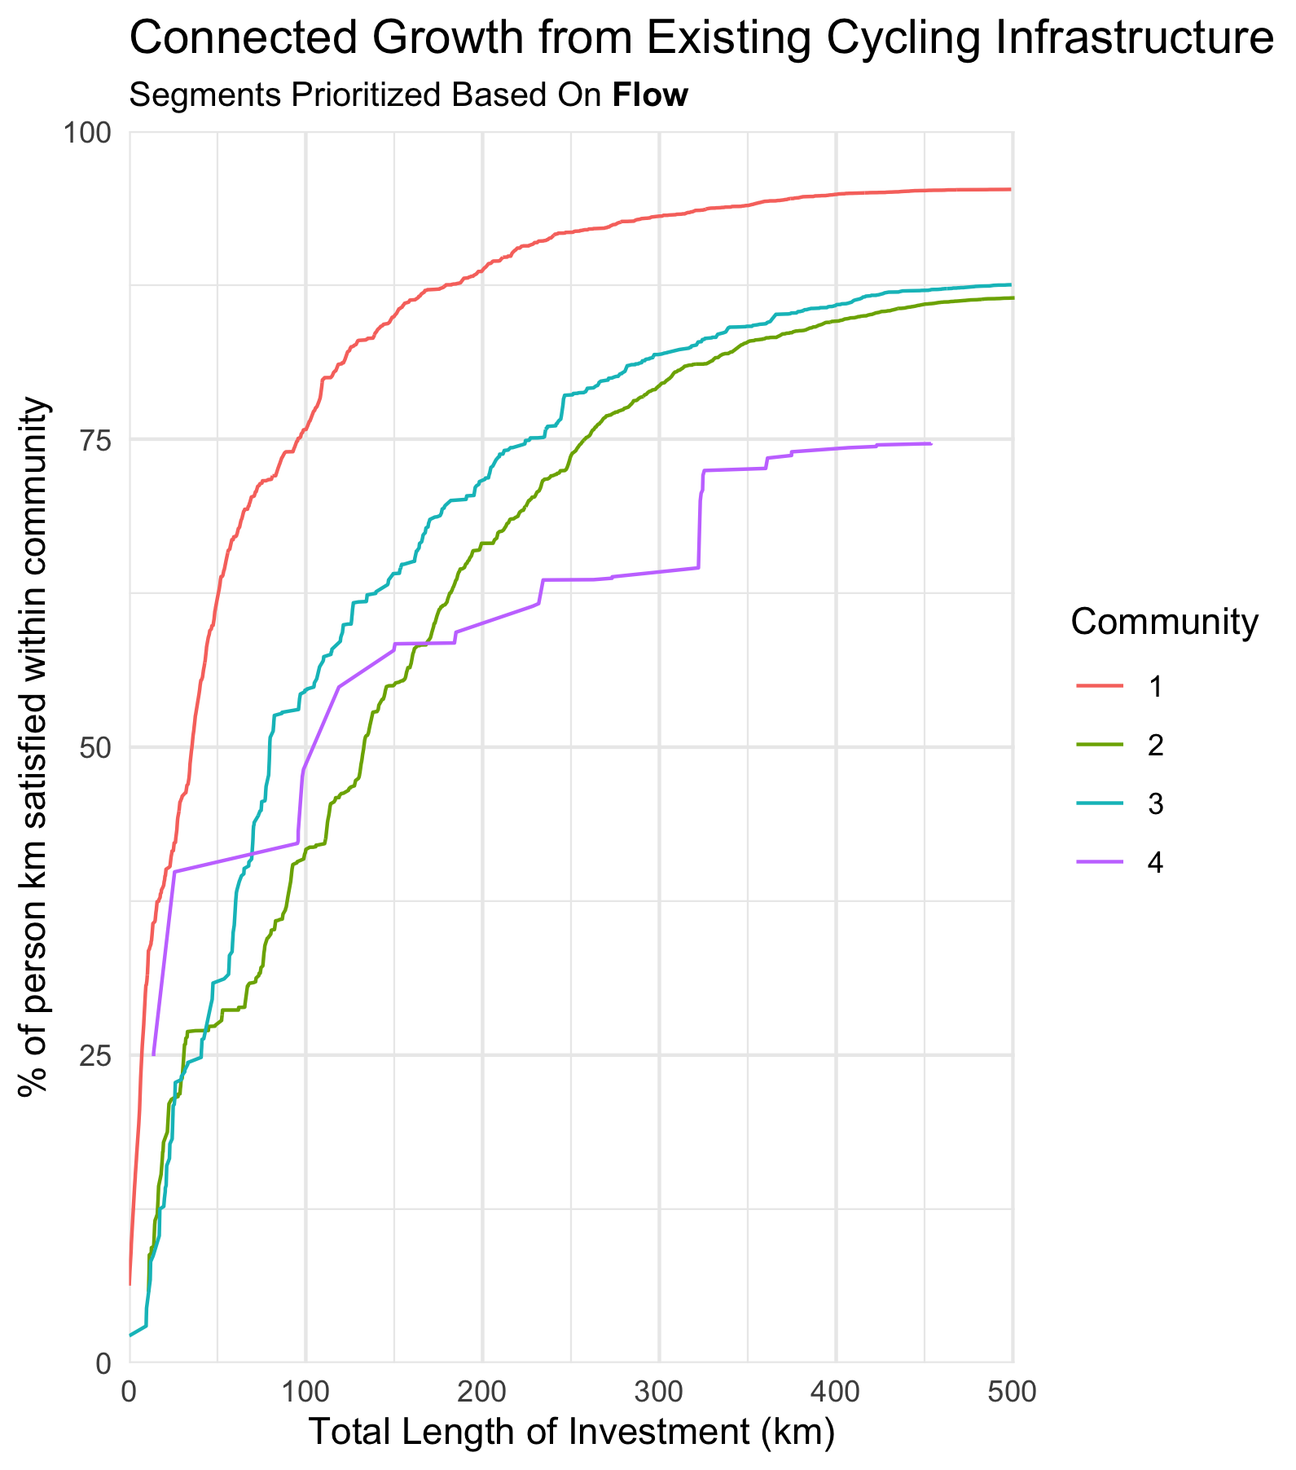
Connected Growth From Existing Infrastructure

Slide 21
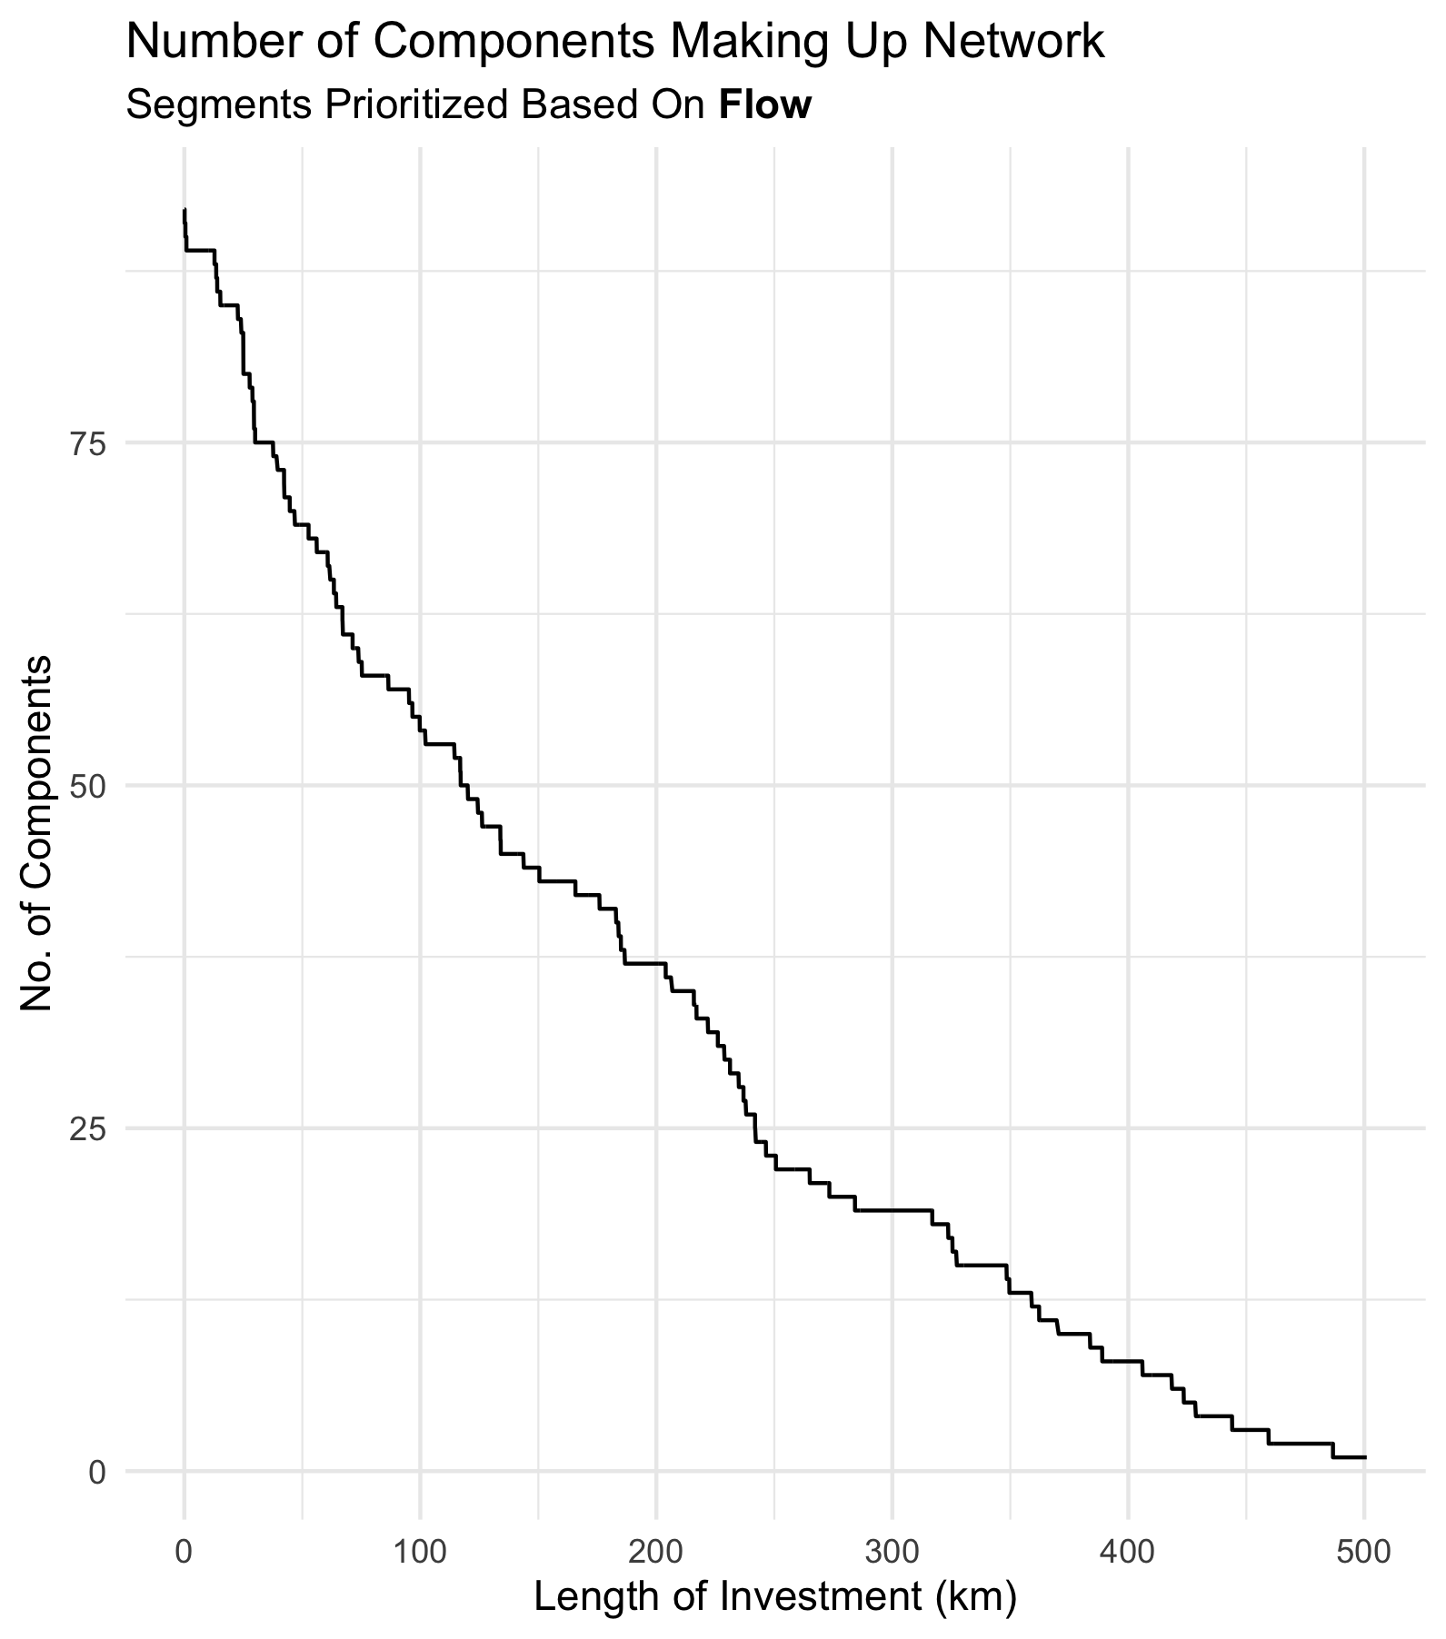
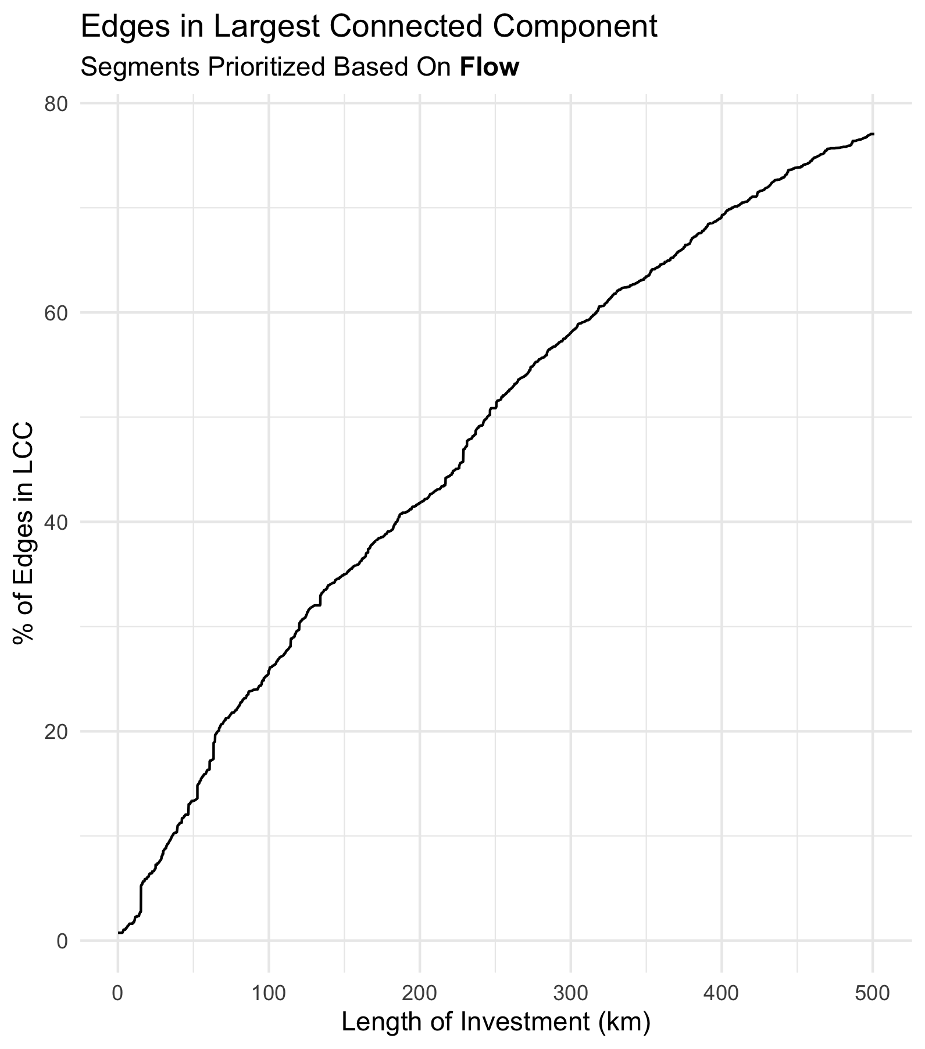

Slide 22
Growing A Network – Multiple Seeds
If we grow a network incrementally from one edge, we will not get proper distribution of investment. We want to start with multiple seeds. We can use community detection to achieve this

Slide 23
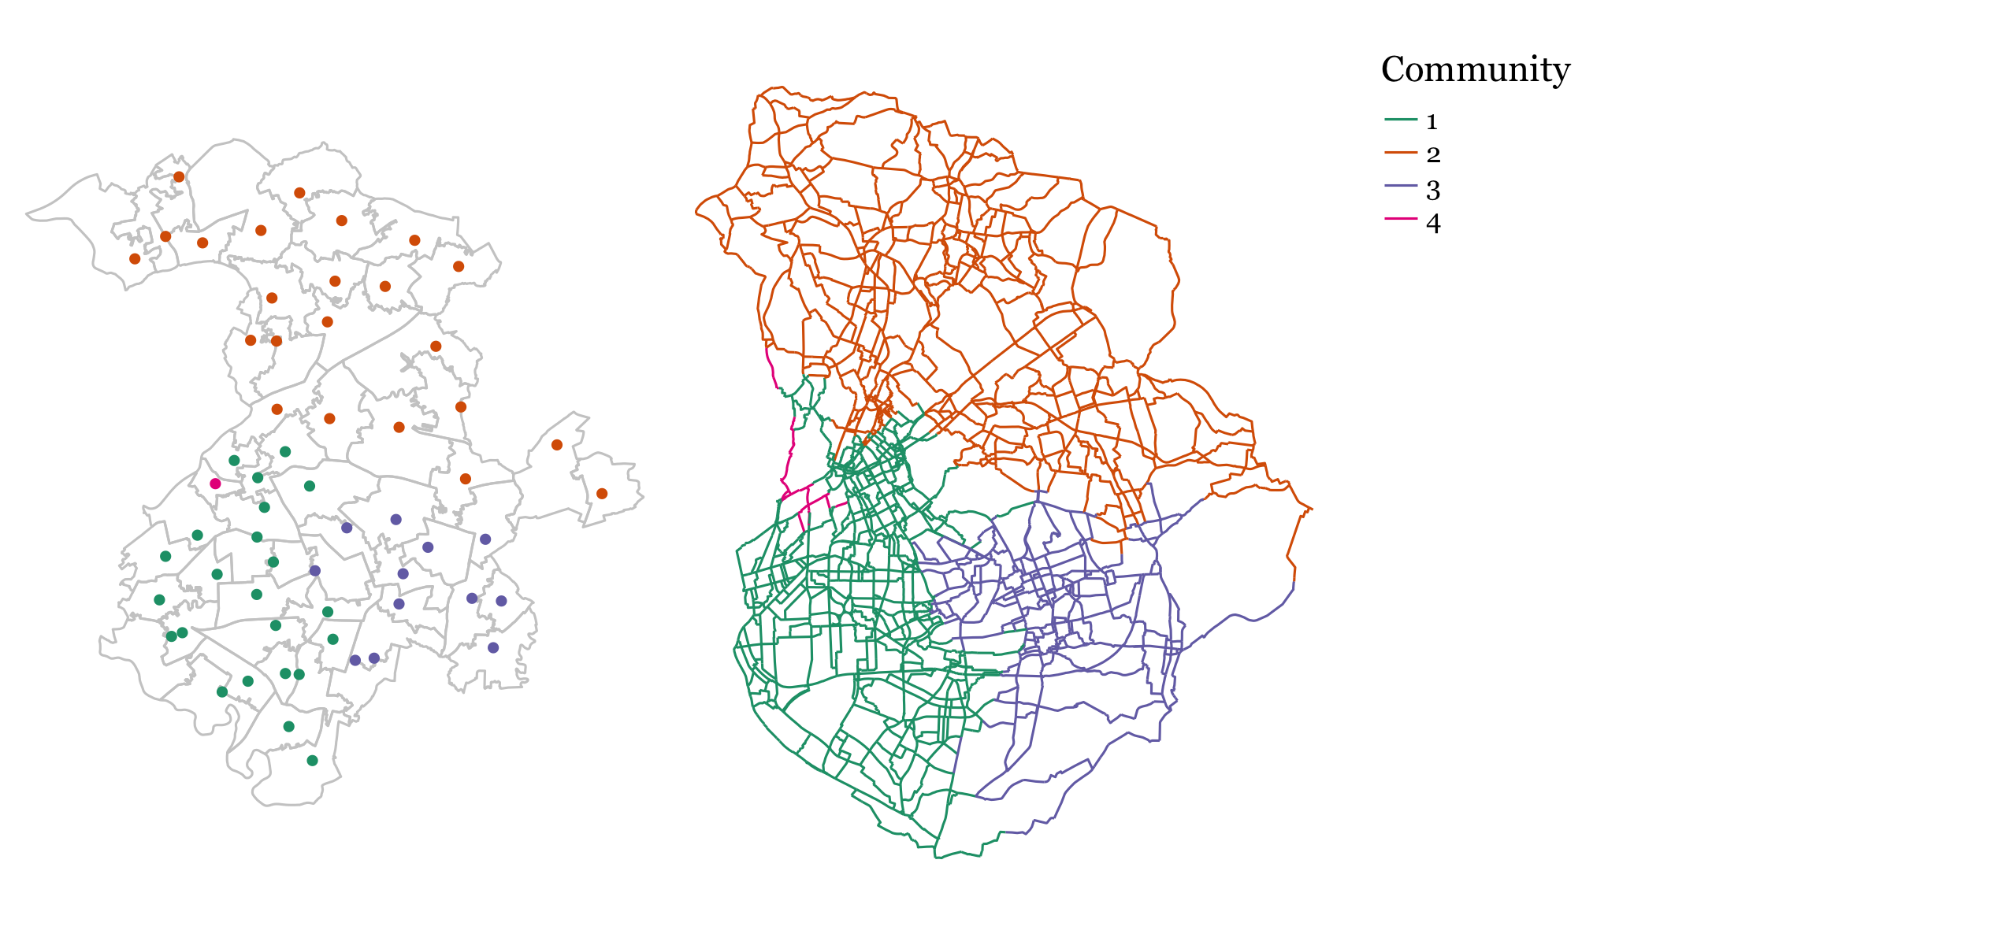
Communities –Louvian Algorithm
MSOAs assigned to communities based on potential flow between them
Edges assigned to communities based on their proximity to MSOA centroids

Slide 24
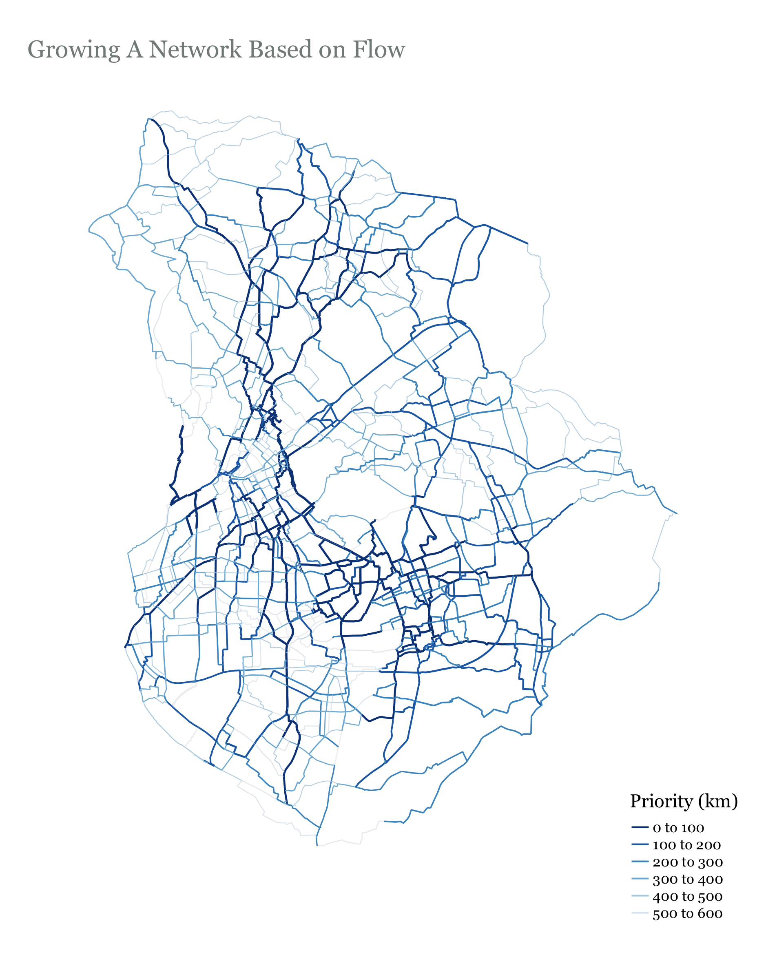
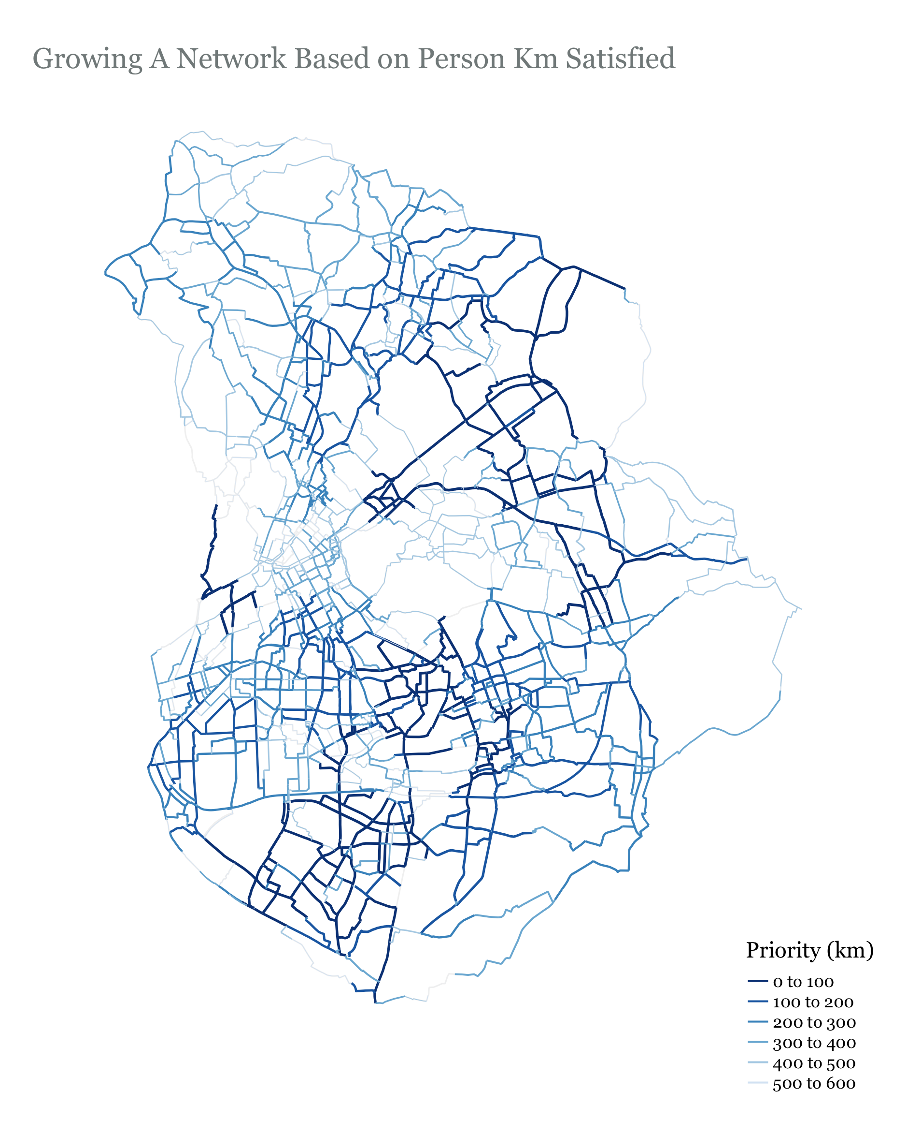

Slide 25
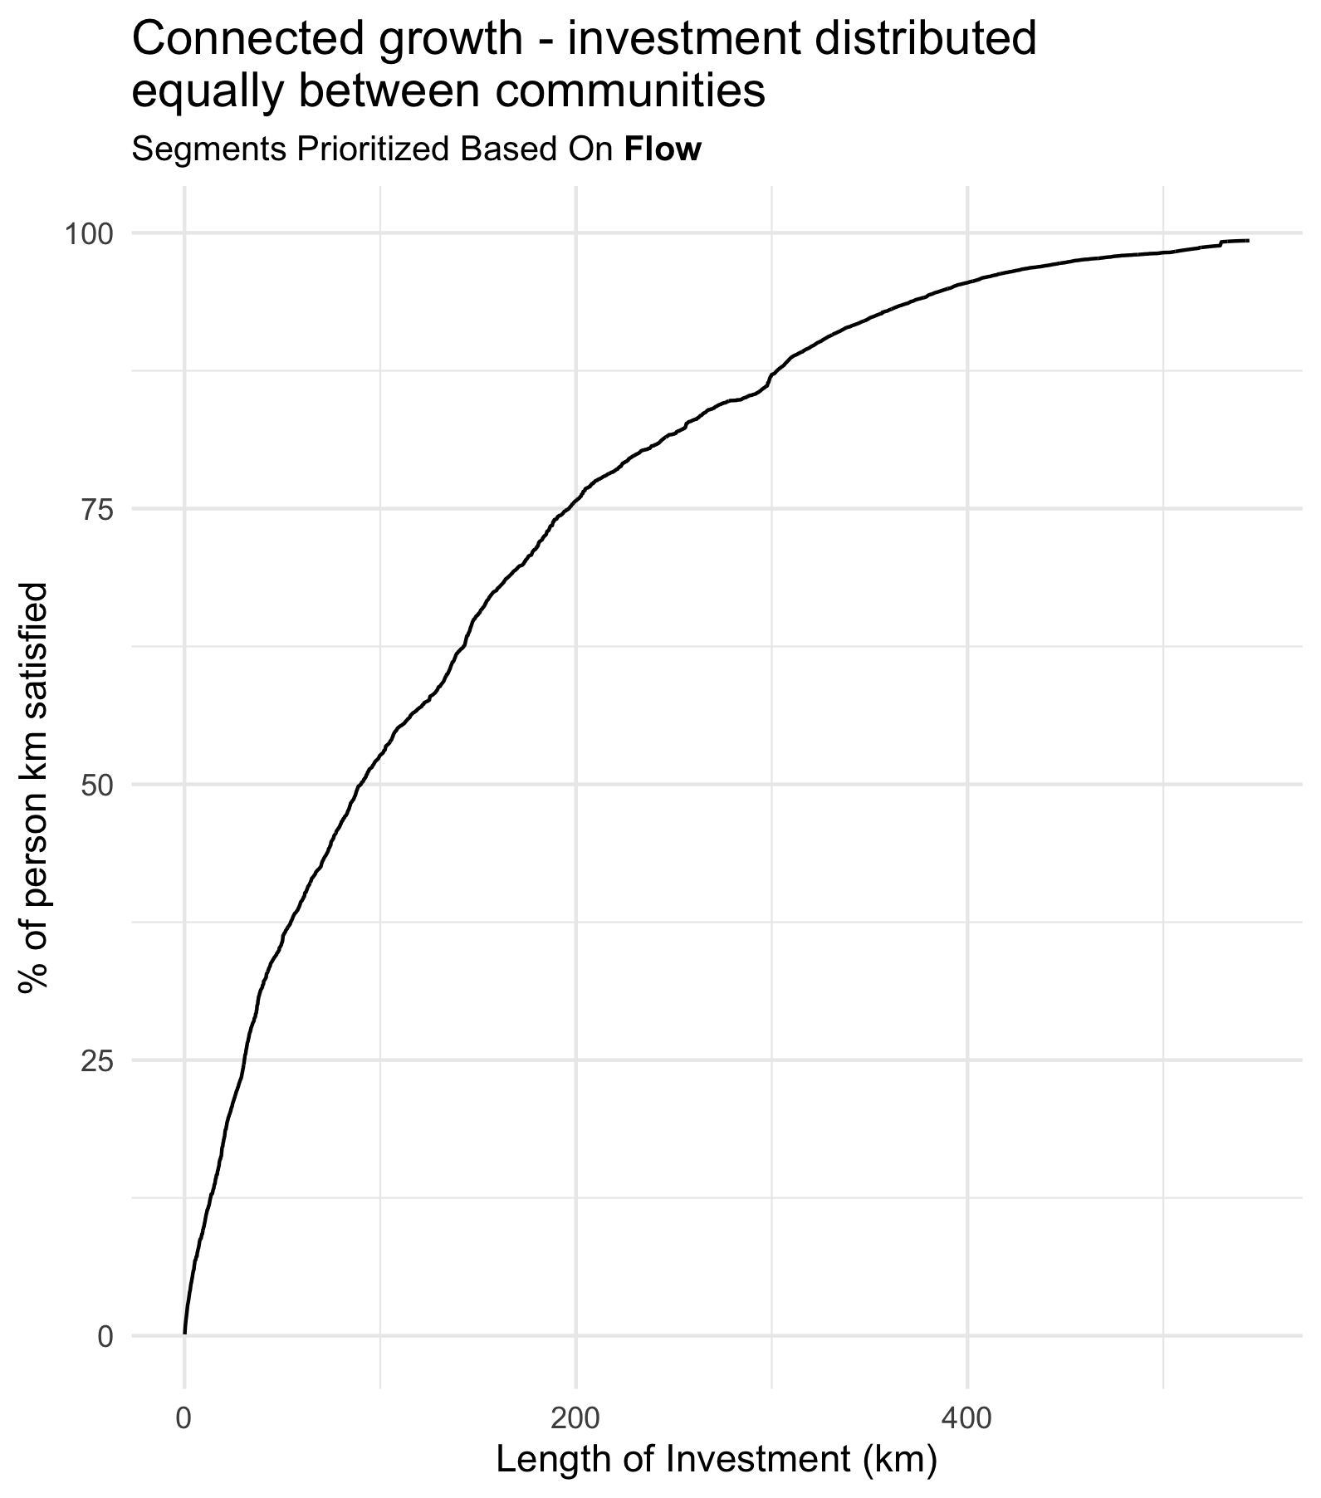
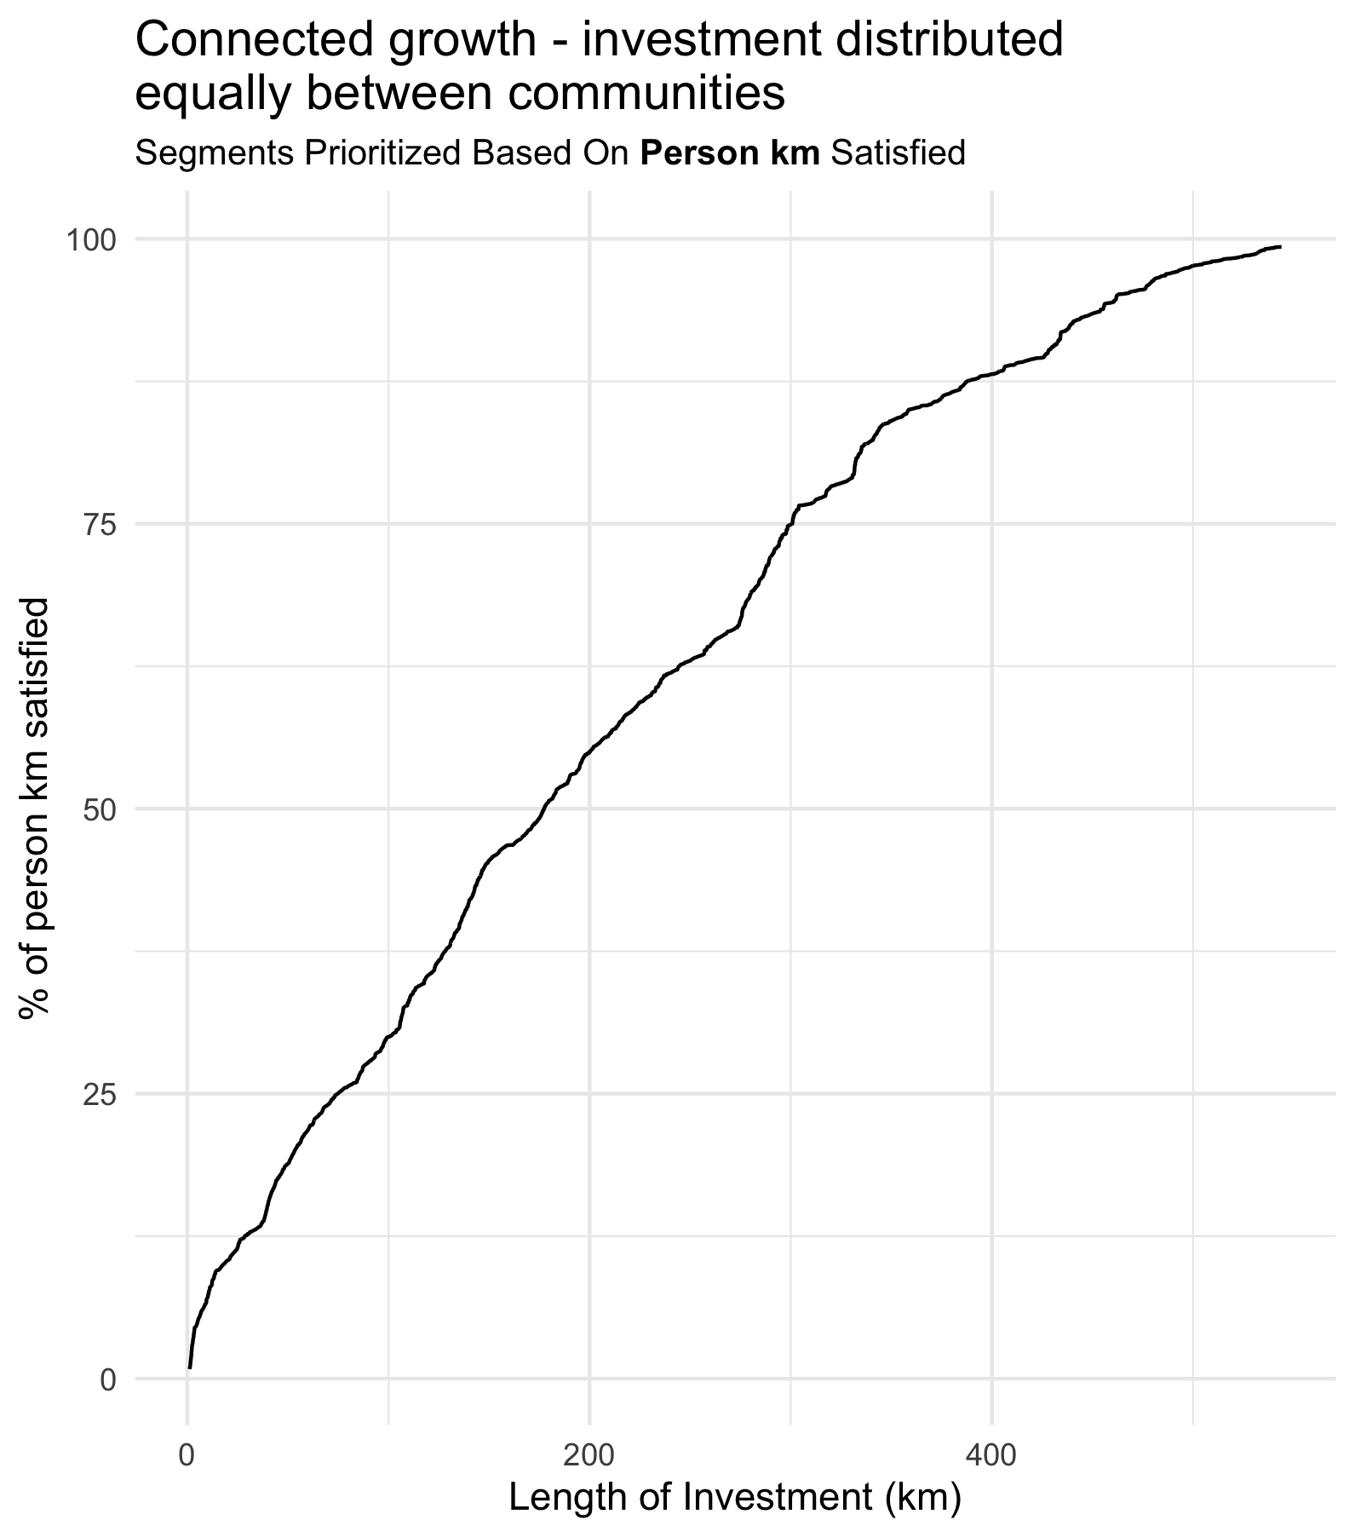

Slide 26
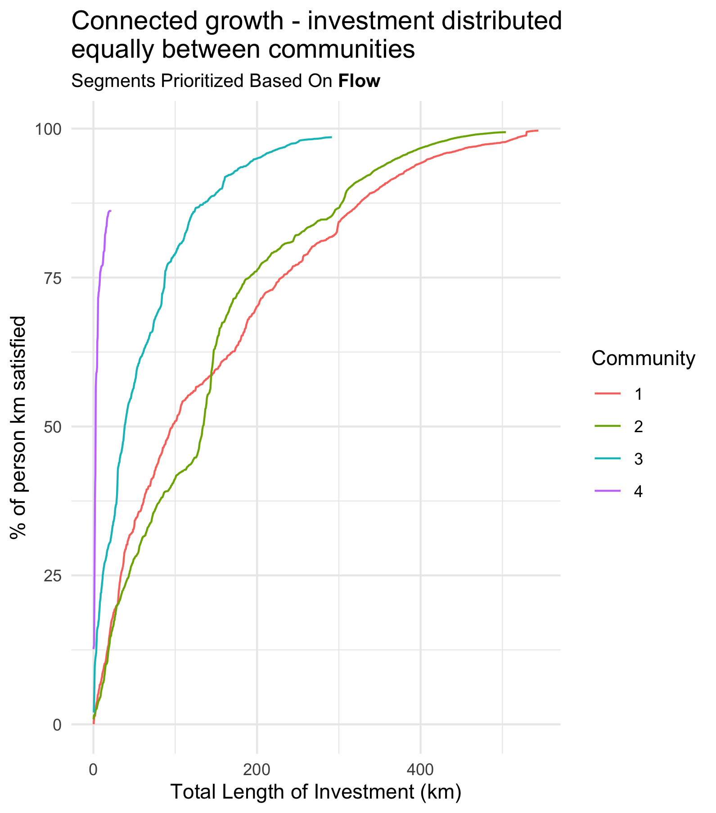
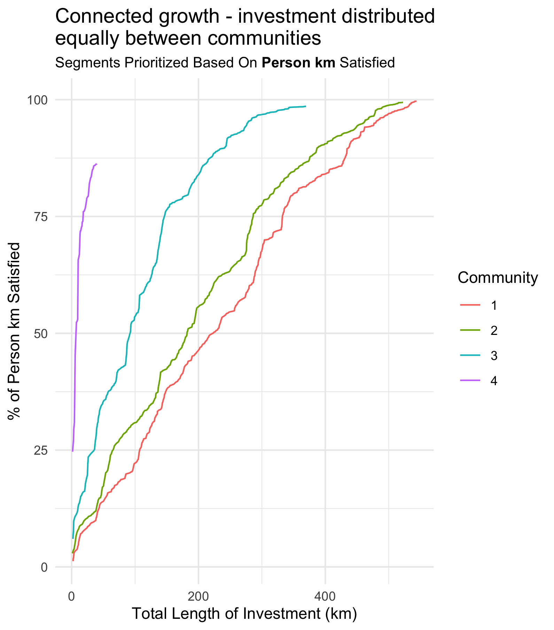

Slide 28
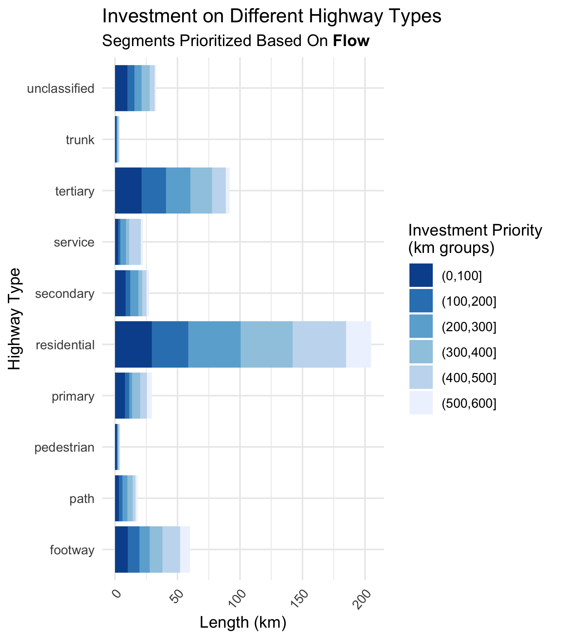
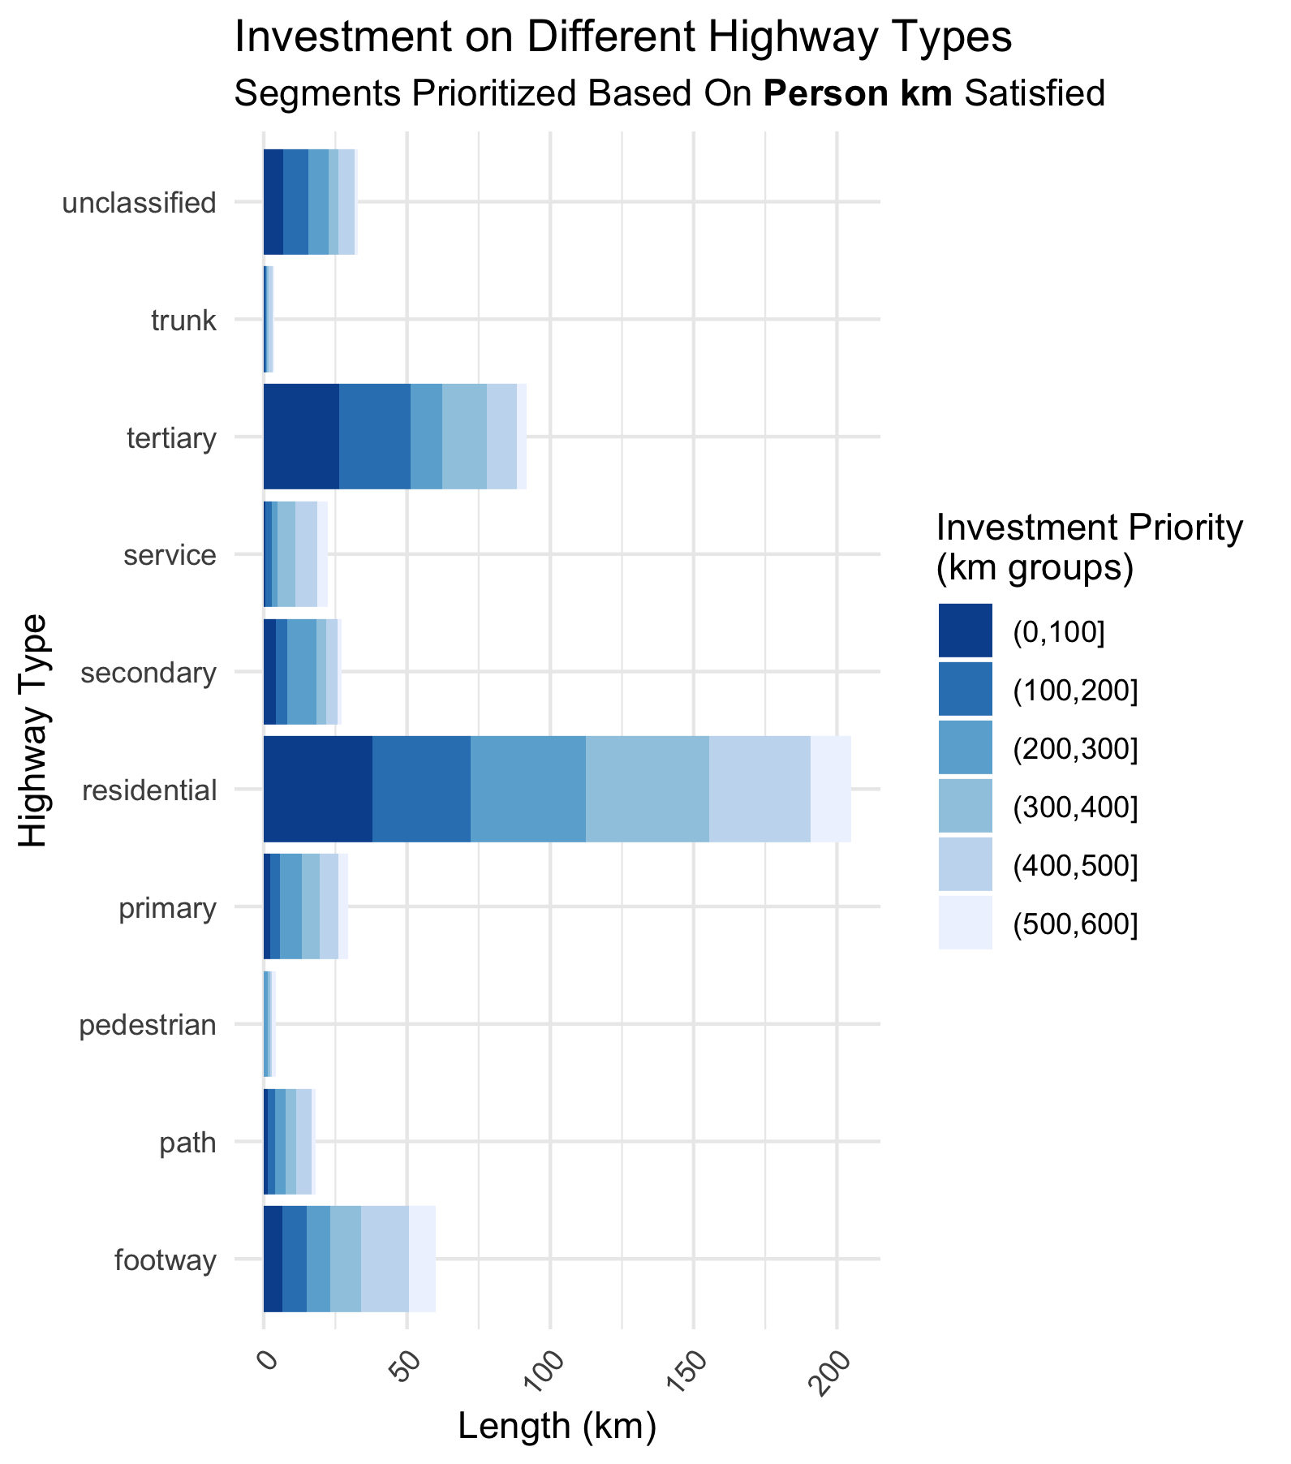

Slide 29
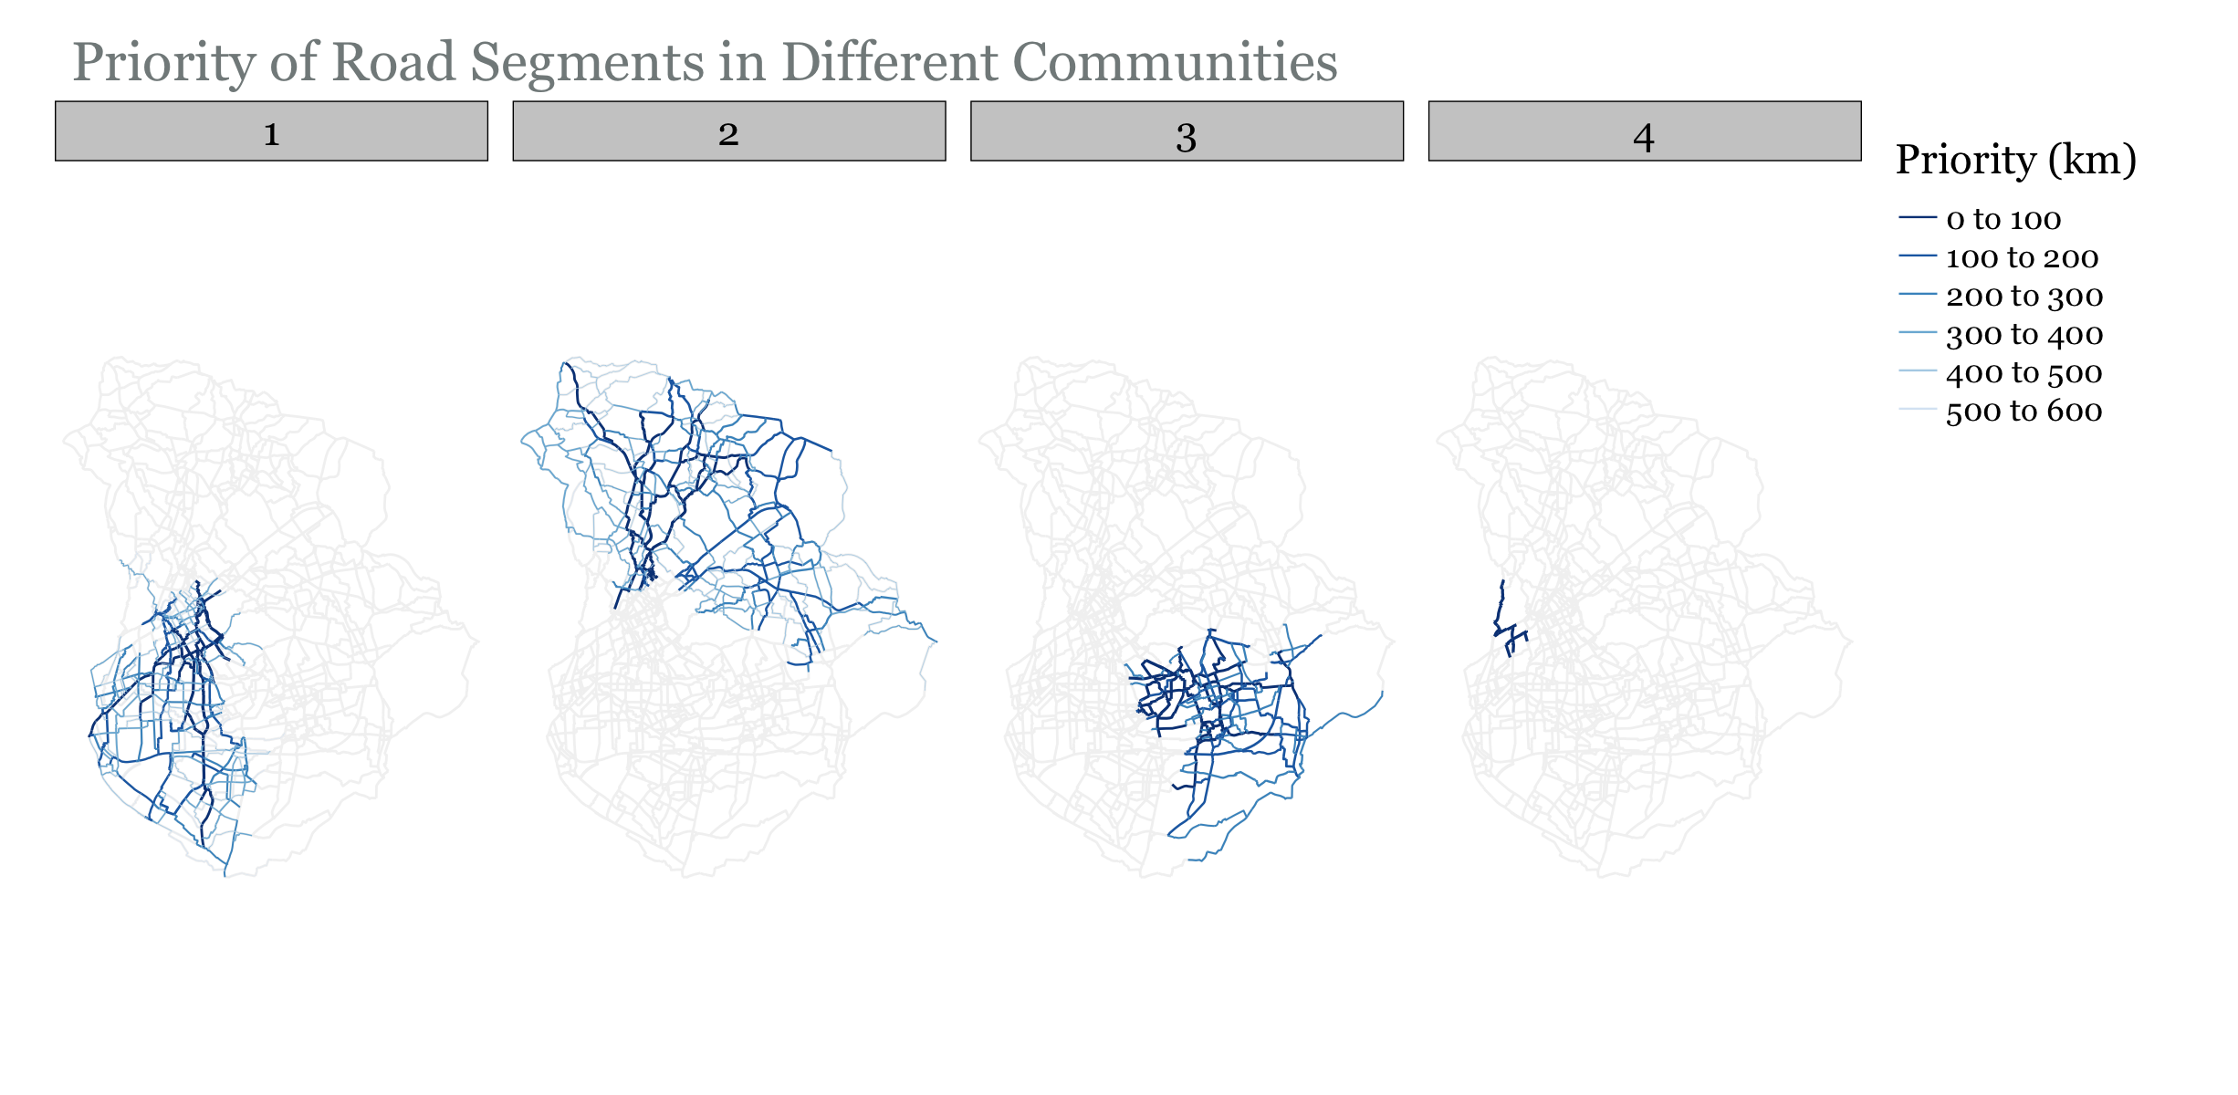

Slide 30
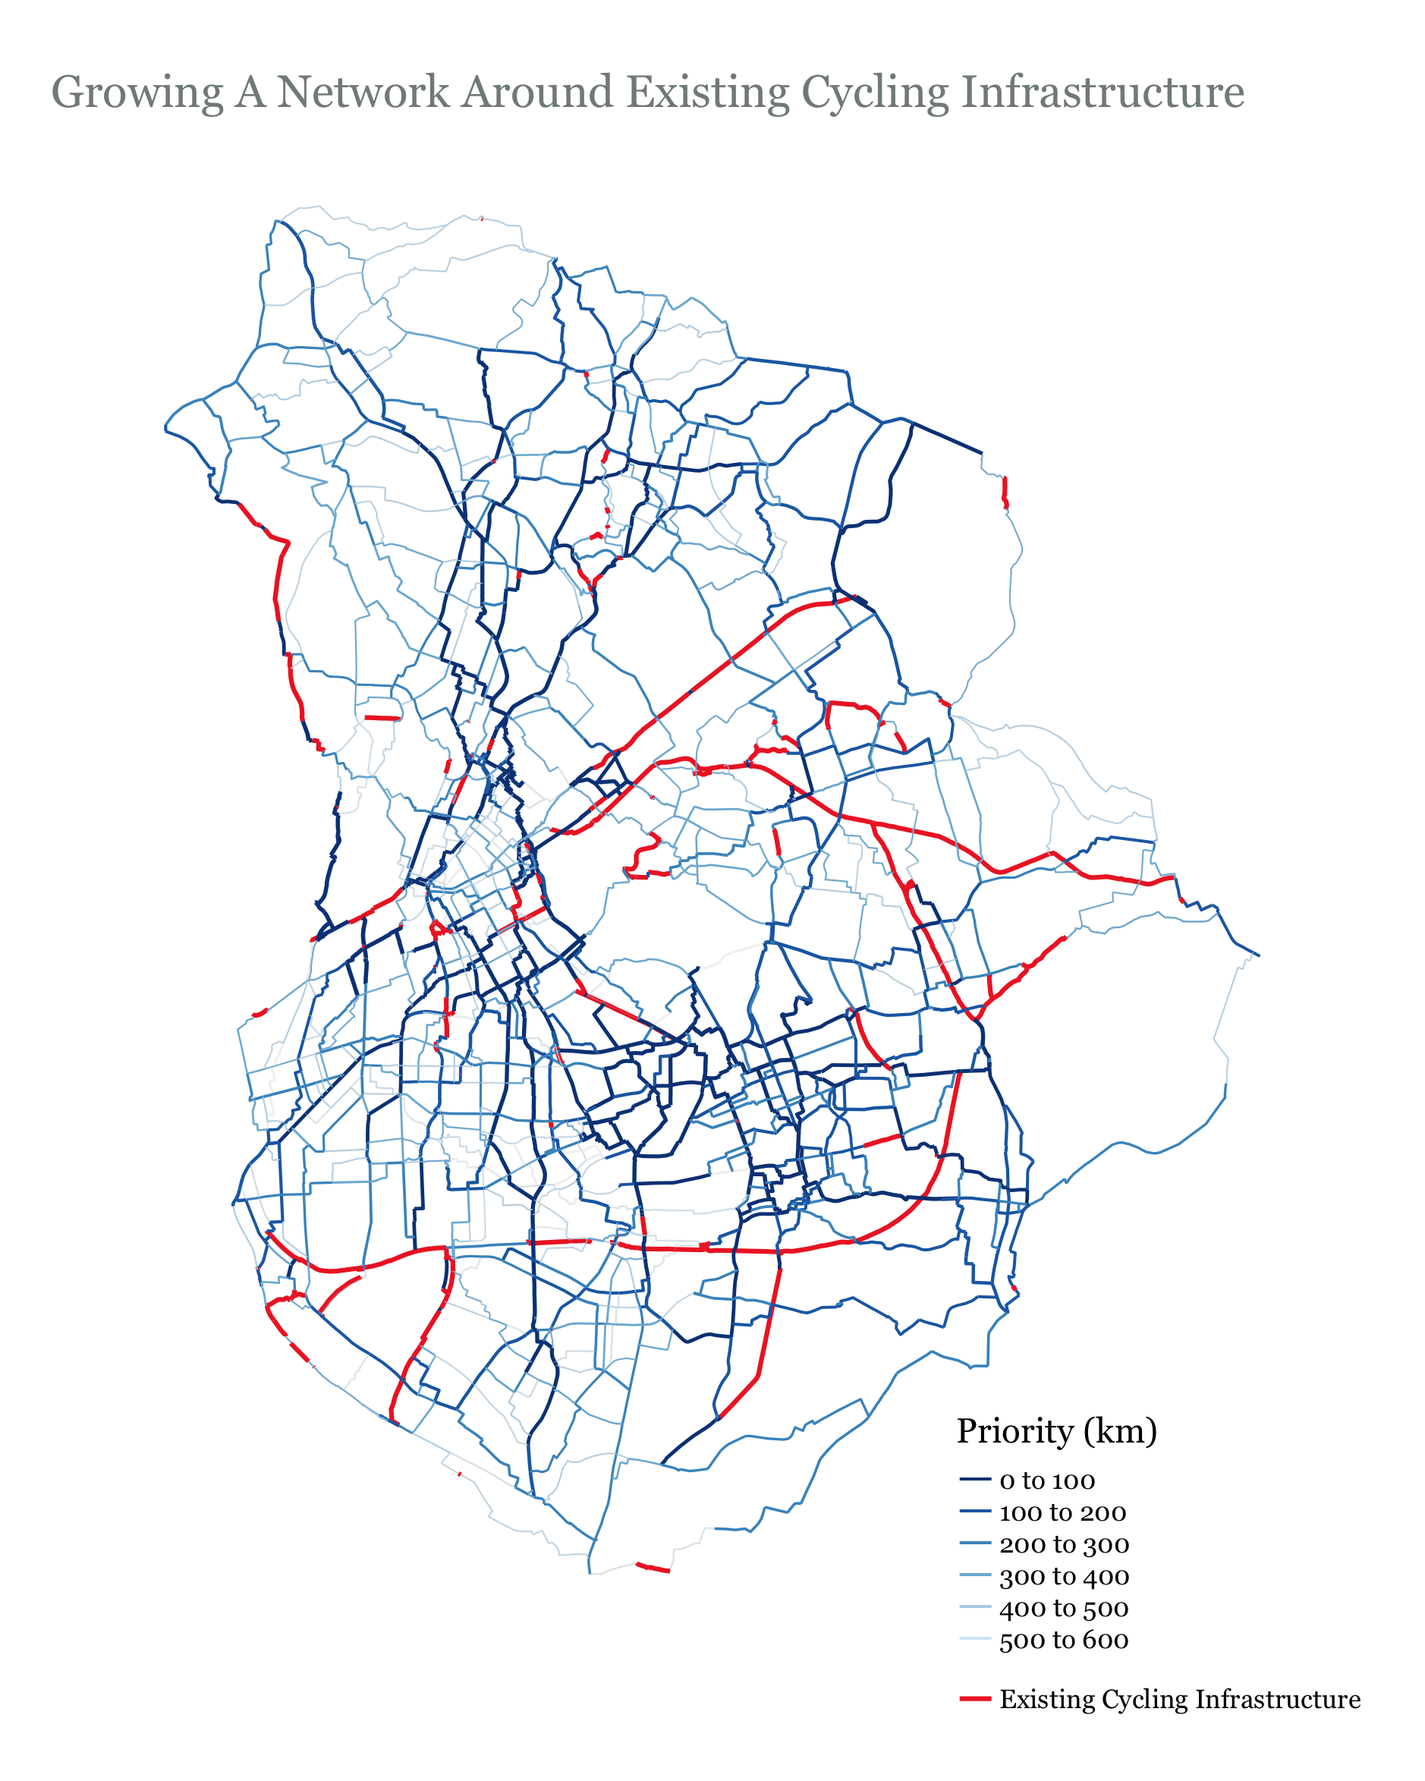

Slide 31
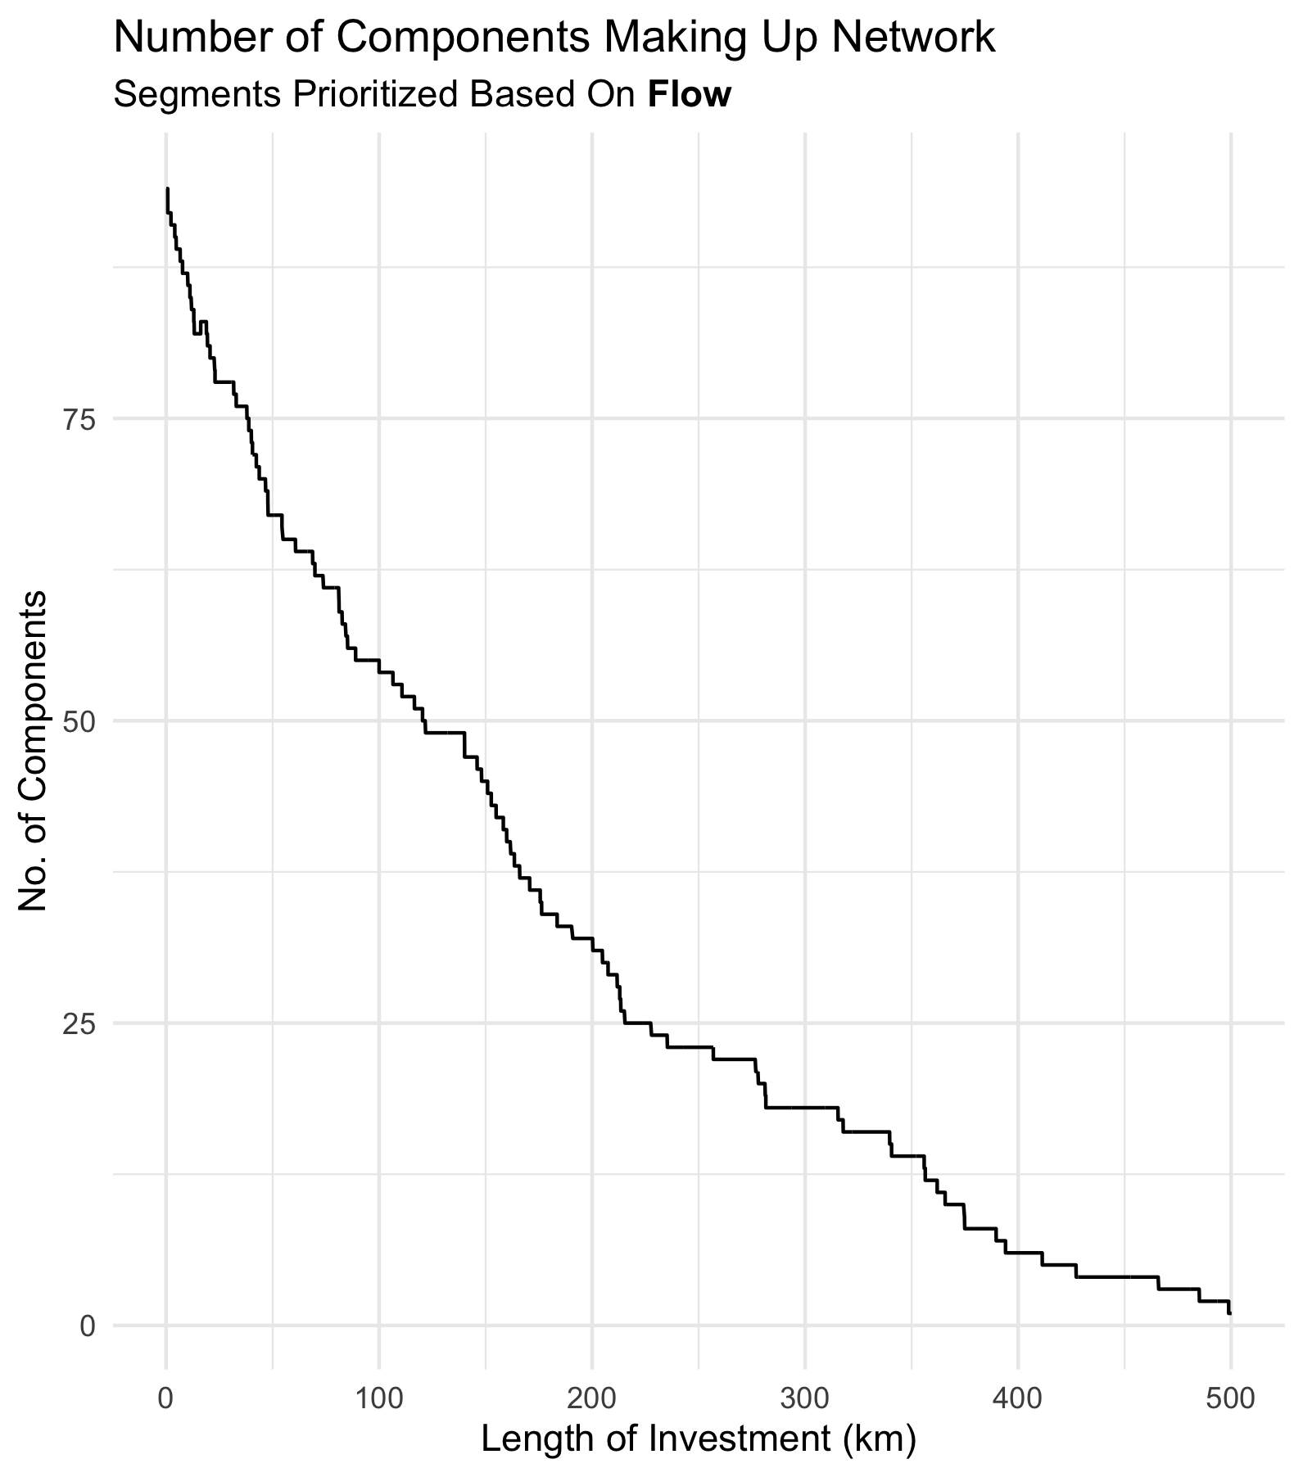
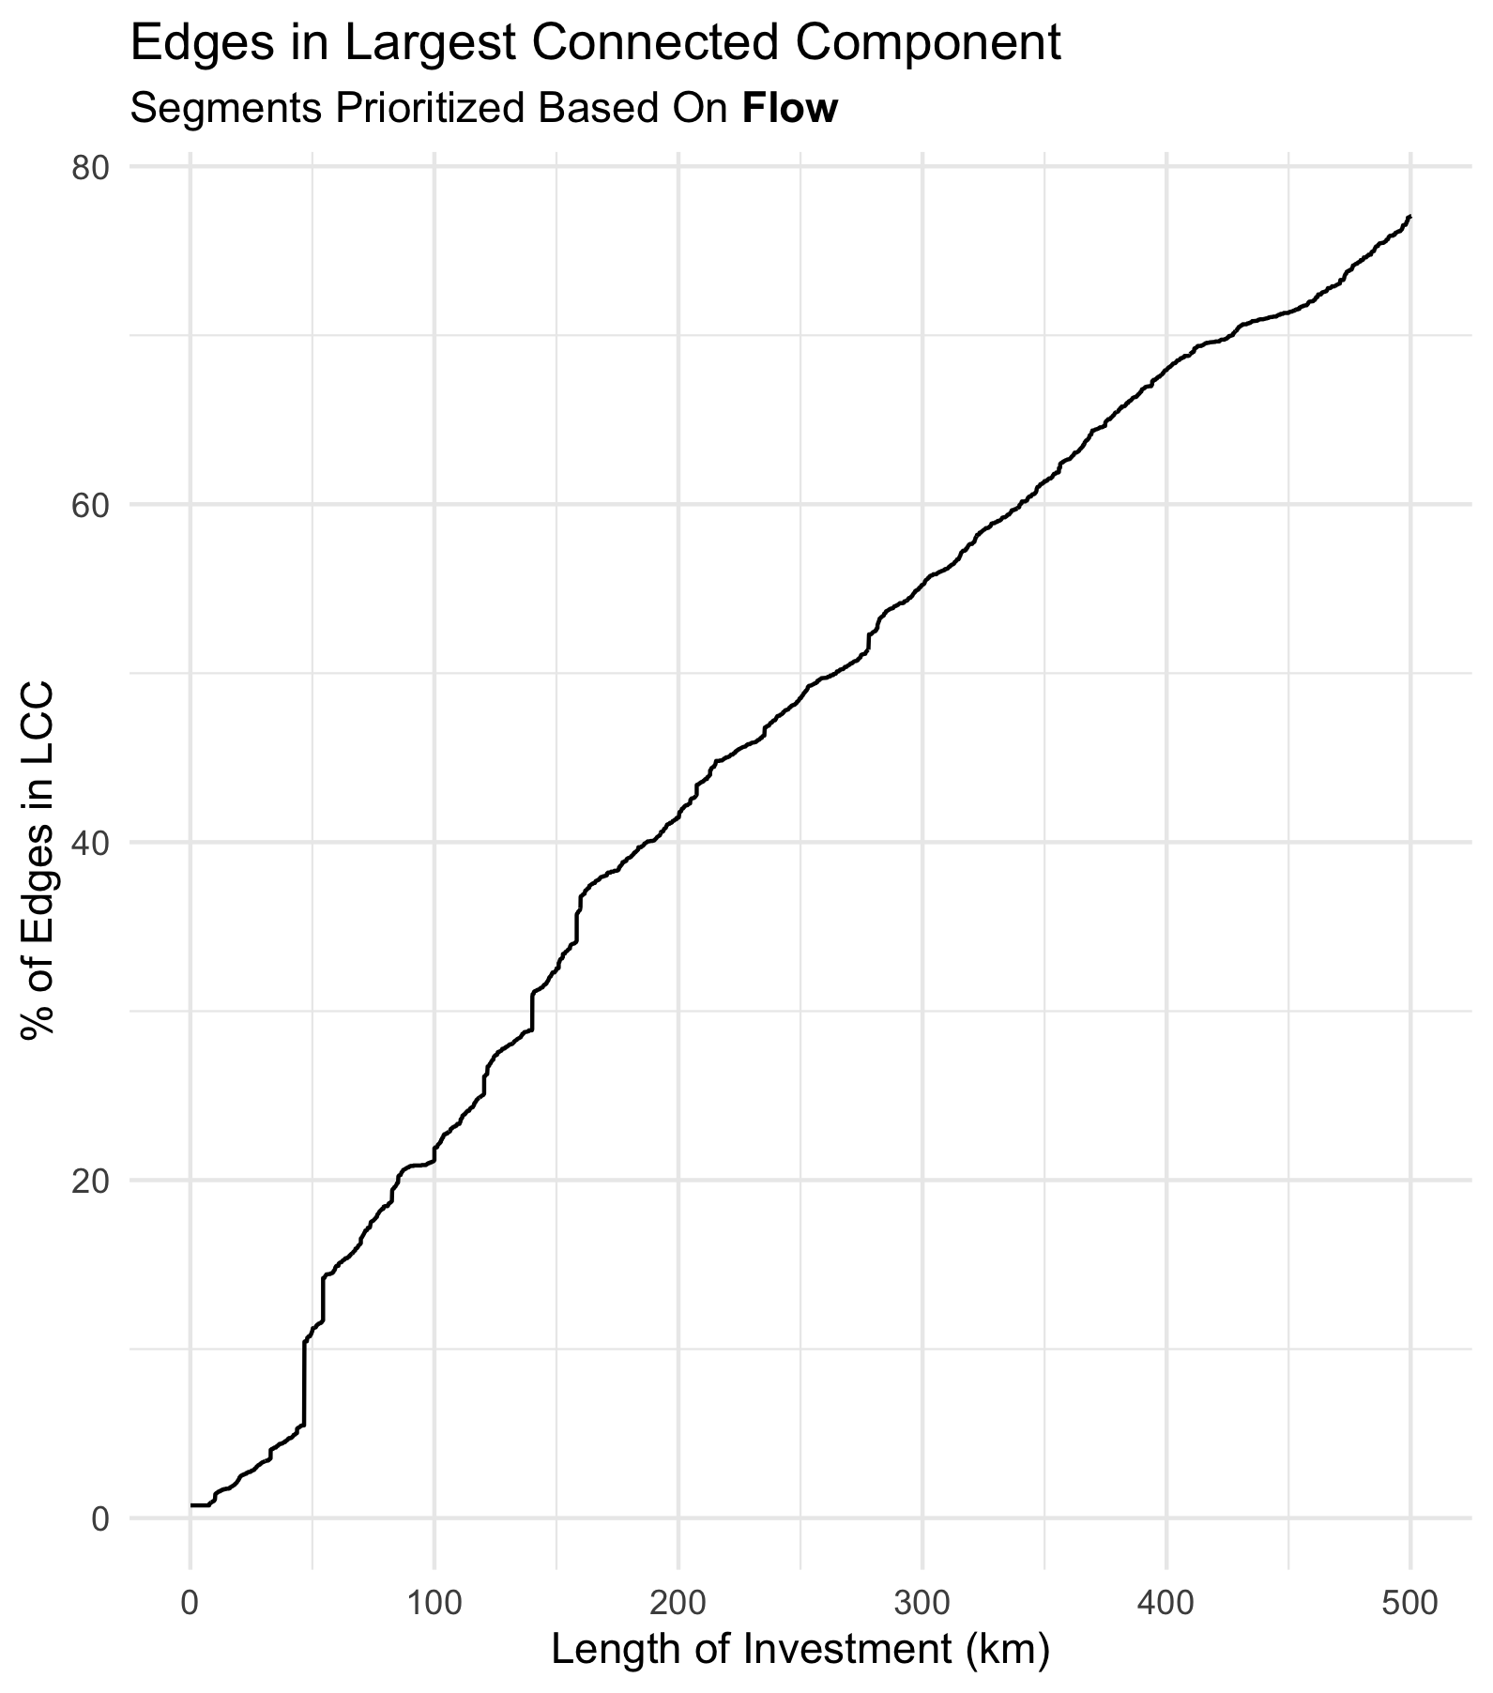

Slide 32
